Slide 1
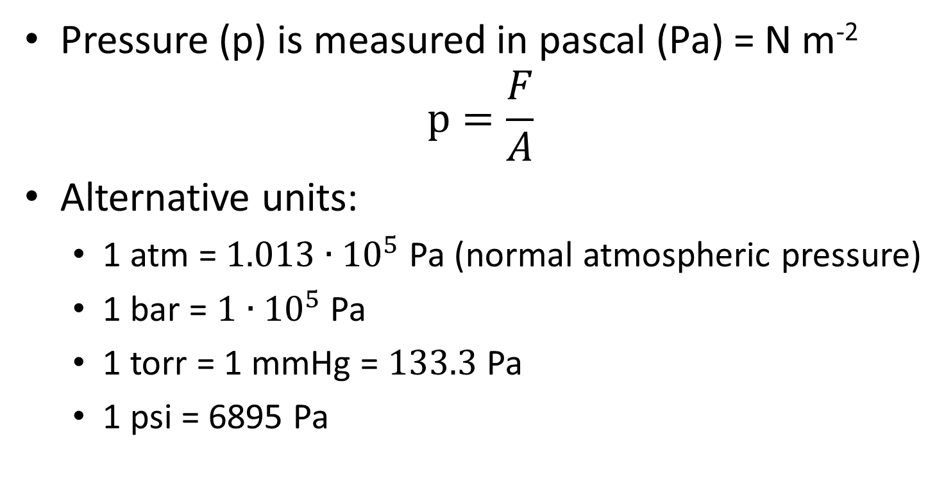
3.2 Modelling a gas
Pressure (p) is measured in pascal (Pa) = N m⁻²
$p=\frac{F}{A}$
Alternative units:
  1 atm = $1.013∙{10}^{5}$Pa (normal atmospheric pressure)
  1 bar = $1∙{10}^{5}$ Pa
  1 torr = 1 mmHg = $133.3$Pa
  1 psi = 6895 Pa

Slide 2
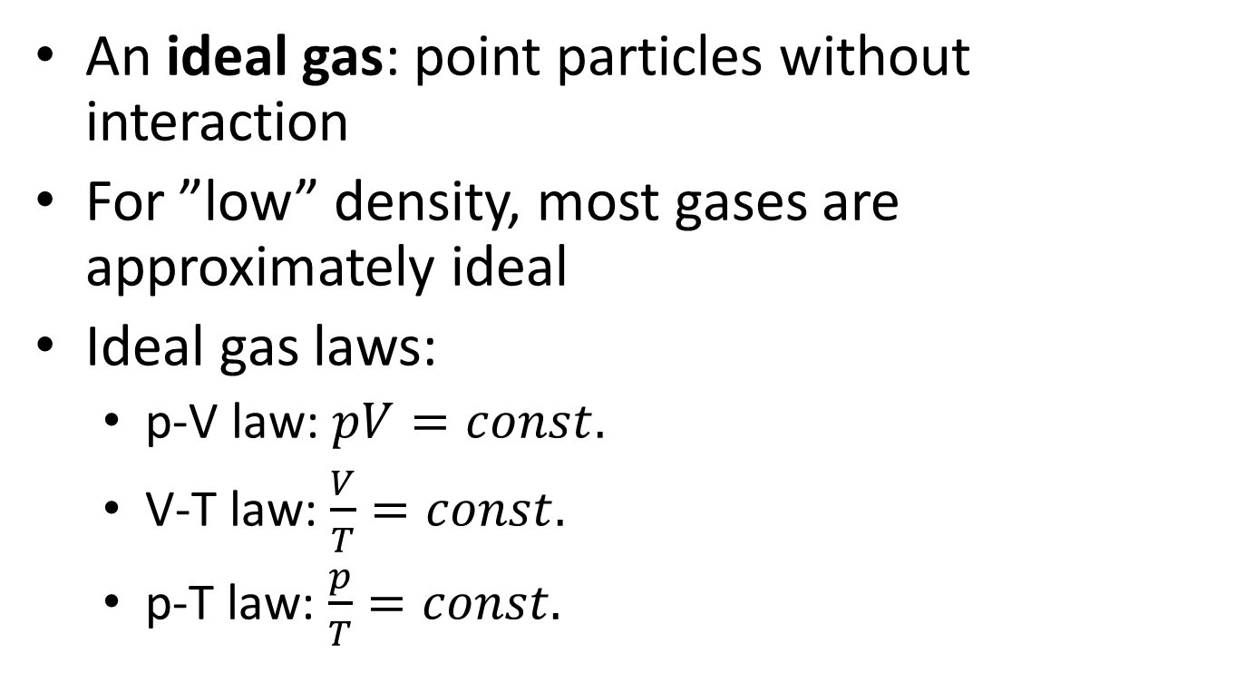
An ideal gas: point particles without interaction
For ”low” density, most gases are approximately ideal
Ideal gas laws:
  p-V law: $pV=const.$
  V-T law: $\frac{V}{T}=const.$
  p-T law: $\frac{p}{T}=const.$

Slide 3
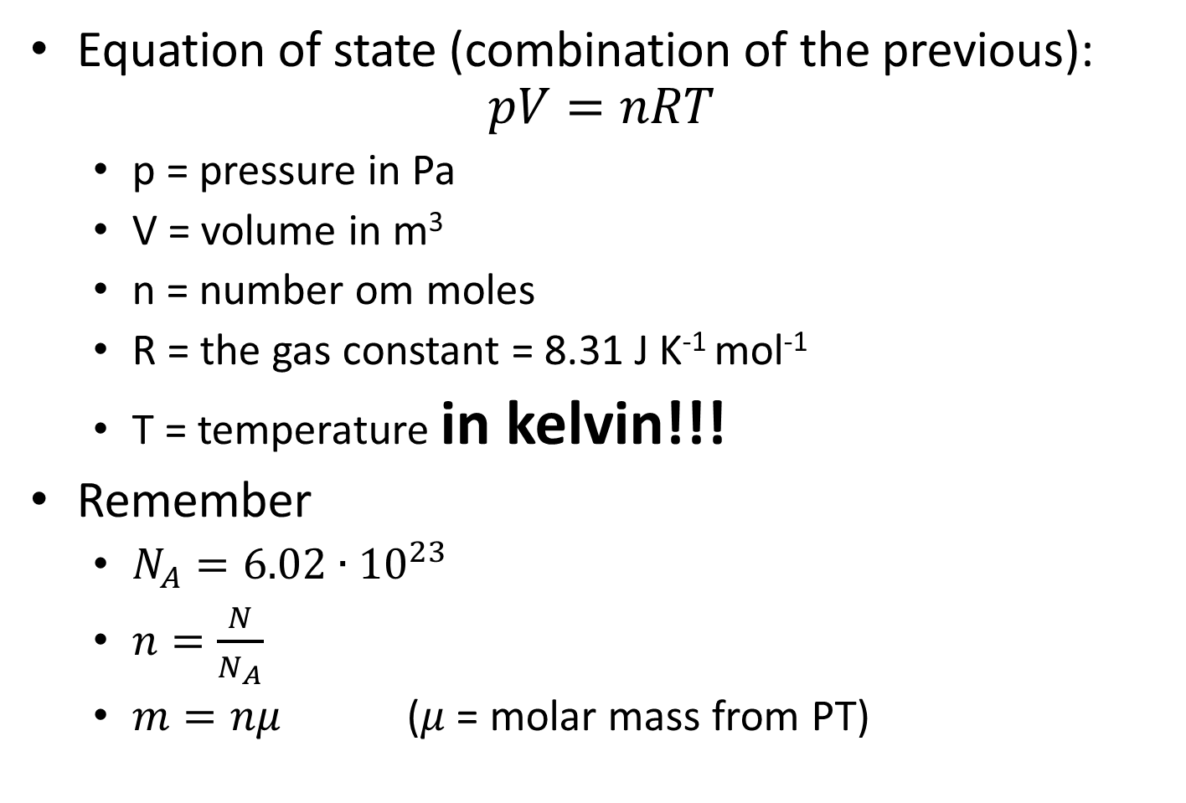
Equation of state (combination of the previous):
$pV=nRT$
  p = pressure in Pa
  V = volume in m³
  n = number om moles
  R = the gas constant = 8.31 J K⁻¹ mol⁻¹
  T = temperature in kelvin!!!
Remember
  $N_{A}=6.02∙{10}^{23}$
  $n=\frac{N}{N_{A}}$
  $m=nμ$ ($μ$= molar mass from PT)

Slide 4
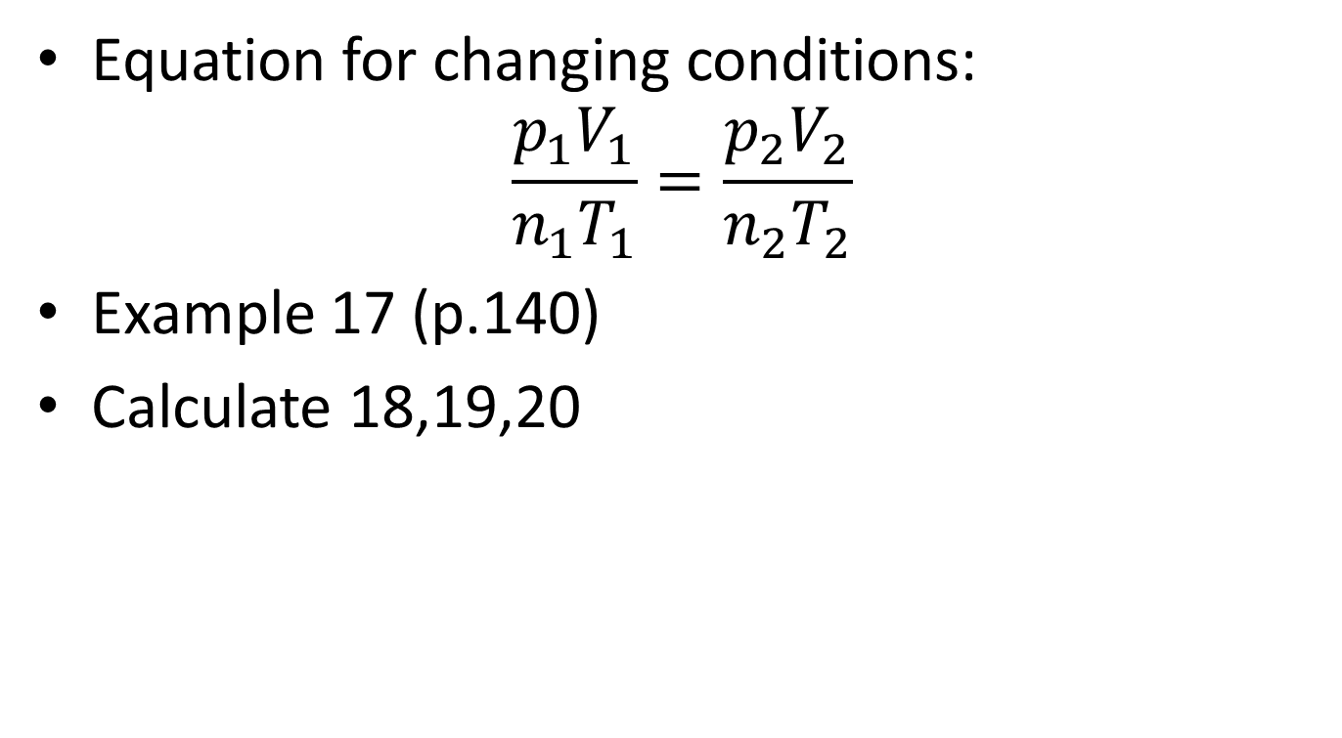
Equation for changing conditions:
$\frac{p_{1}V_{1}}{n_{1}T_{1}}=\frac{p_{2}V_{2}}{n_{2}T_{2}}$
Example 17 (p.140)
Calculate 18,19,20

