Slide 1
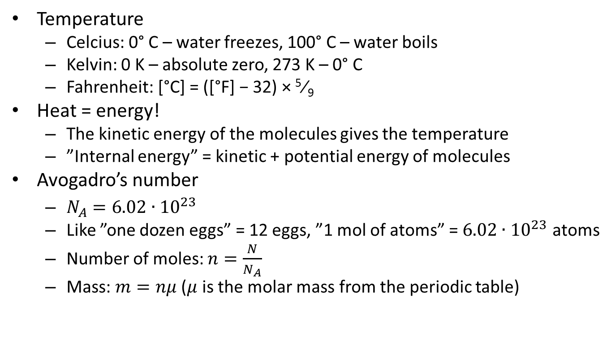
3.1 Thermal concepts
Temperature
  Celcius: 0° C – water freezes, 100° C – water boils
  Kelvin: 0 K – absolute zero, 273 K – 0° C
  Fahrenheit: [°C] = ([°F] − 32) × ⁵⁄₉
Heat = energy!
  The kinetic energy of the molecules gives the temperature
  ”Internal energy” = kinetic + potential energy of molecules
Avogadro’s number
  $N_{A}=6.02∙{10}^{23}$
  Like ”one dozen eggs” = 12 eggs, ”1 mol of atoms” = $6.02∙{10}^{23}$ atoms
  Number of moles: $n=\frac{N}{N_{A}}$
  Mass: $m=nμ$ ($μ$ is the molar mass from the periodic table)

Slide 2
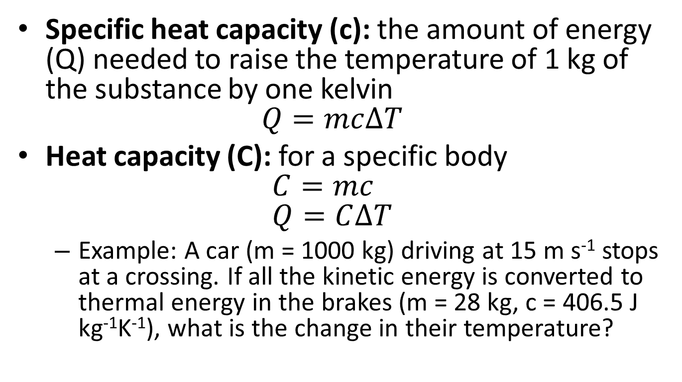
Specific heat capacity (c): the amount of energy (Q) needed to raise the temperature of 1 kg of the substance by one kelvin
$Q=mc∆T$
Heat capacity (C): for a specific body
$C=mc$
$Q=C∆T$
  Example: A car (m = 1000 kg) driving at 15 m s⁻¹ stops at a crossing. If all the kinetic energy is converted to thermal energy in the brakes (m = 28 kg, c = 406.5 J kg⁻¹K⁻¹), what is the change in their temperature?

Slide 3
Thermal equilibrium: energy flows from a warmer object to a colder, until both have the same temperature
  Example: A piece of iron (m = 0.2 kg, T = 300°C, c = 470 J kg⁻¹K⁻¹) is dropped into water (m = 1 kg, T = 20°C, c = 4200 J kg⁻¹K⁻¹). What will their final temperature be?

Slide 4
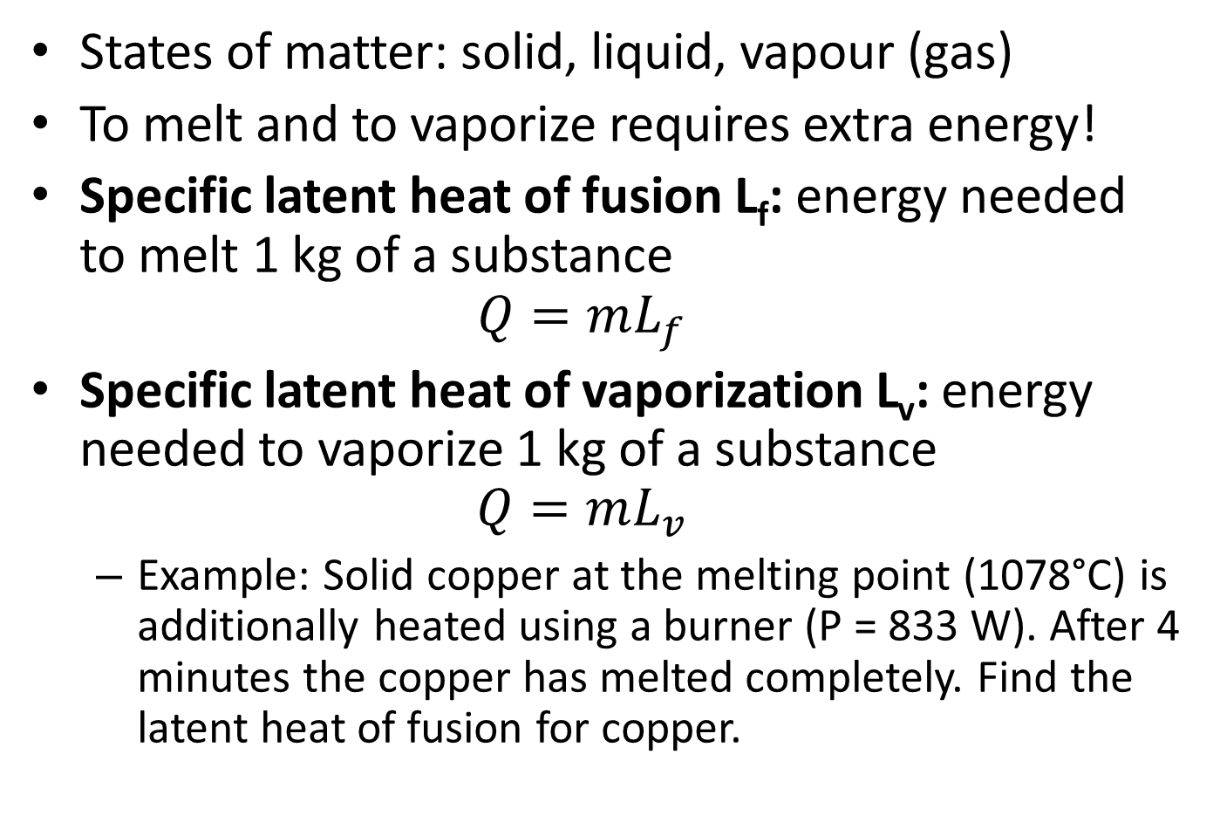
States of matter: solid, liquid, vapour (gas)
To melt and to vaporize requires extra energy!
Specific latent heat of fusion L_{f}: energy needed to melt 1 kg of a substance
$Q=mL_{f}$
Specific latent heat of vaporization L_{v}: energy needed to vaporize 1 kg of a substance
$Q=mL_{v}$
  Example: Solid copper at the melting point (1078°C) is additionally heated using a burner (P = 833 W). After 4 minutes the copper has melted completely. Find the latent heat of fusion for copper.

Slide 5
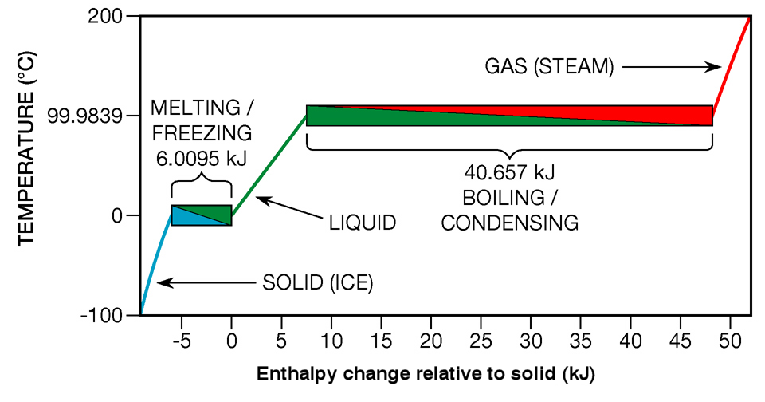
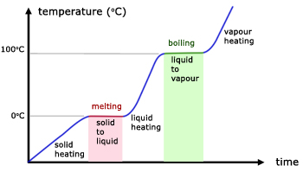
Questions 2, 3, 4, 5, 6 (p. 171)

