Slide 1
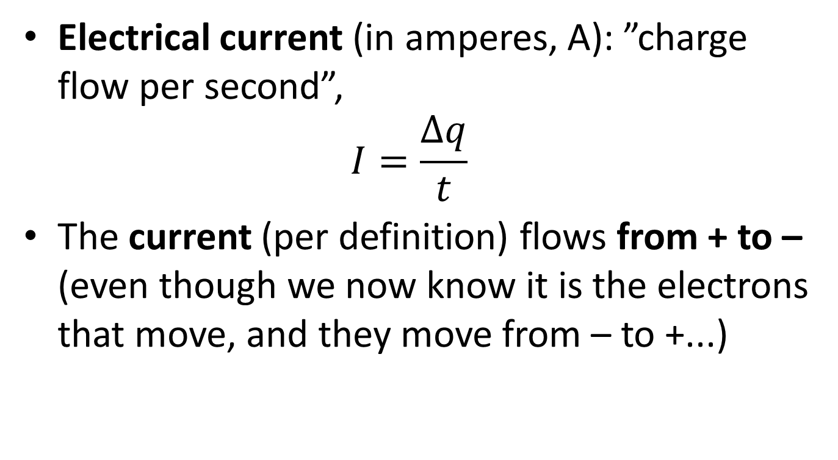
6.2 Current
Electrical current (in amperes, A): ”charge flow per second”,
$I=\frac{∆q}{t}$
The current (per definition) flows from + to – (even though we now know it is the electrons that move, and they move from – to +...)

Slide 2
Circuit symbols (formula booklet p. 4)
Symbol | Component
 | Lead (wire)
 | Cell (battery)
 | Resistor
 | Light bulb
 | Ammeter
 | Voltmeter

Slide 3
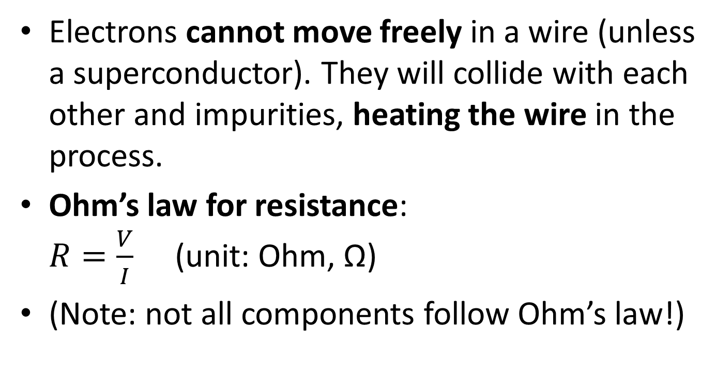
Electrons cannot move freely in a wire (unless a superconductor). They will collide with each other and impurities, heating the wire in the process.
Ohm’s law for resistance:
$R=\frac{V}{I}$ (unit: Ohm, Ω)
(Note: not all components follow Ohm’s law!)

Slide 4
Lab1.
  Connect a light bulb to a battery
  Measure the voltage over the battery
  Measure the current through thelight bulb
  Calculate the resistance
  Make a circuit diagram!
Note! Voltmeter ALWAYS parallel to the measured component, Ammeter ALWAYS in series with the measured component!

Slide 5
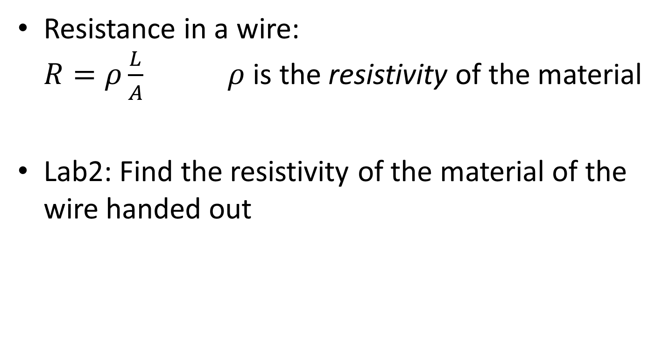
Resistance in a wire:
$R=ρ\frac{L}{A}$ $ρ$ is the resistivity of the material
Lab2: Find the resistivity of the material of the wire handed out

Slide 6
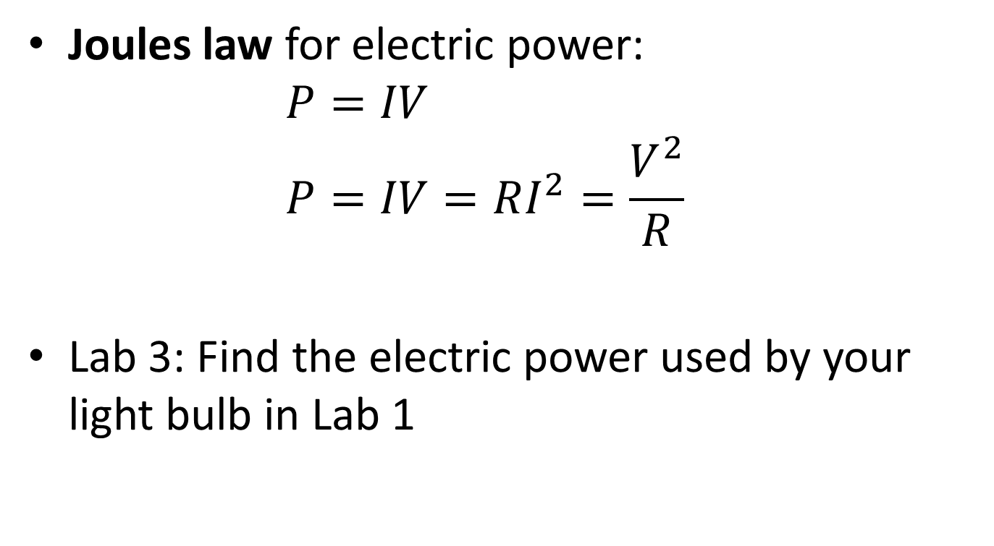
Joules law for electric power:
$P=IV$
$P=IV=RI^{2}=\frac{V^{2}}{R}$
Lab 3: Find the electric power used by your light bulb in Lab 1

Slide 7
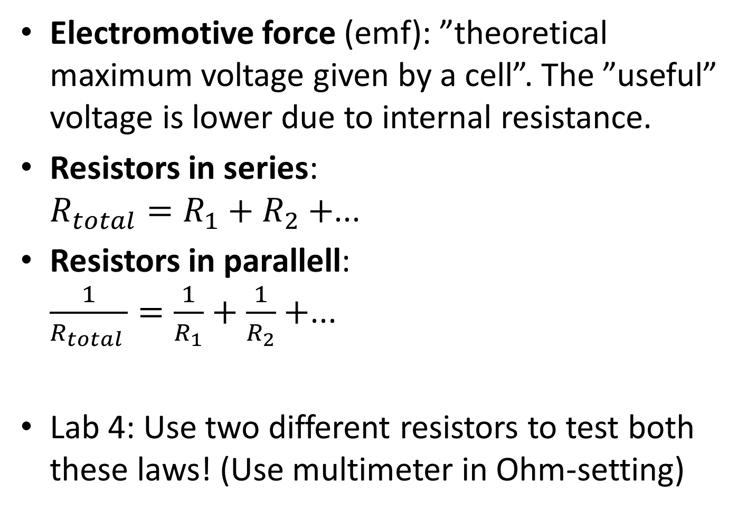
Electromotive force (emf): ”theoretical maximum voltage given by a cell”. The ”useful” voltage is lower due to internal resistance.
Resistors in series:
$R_{total}=R_{1}+R_{2}+$...
Resistors in parallell:
$\frac{1}{R_{total }}=\frac{1}{R_{1}}+\frac{1}{R_{2}}+$...
Lab 4: Use two different resistors to test both these laws! (Use multimeter in Ohm-setting)

Slide 8
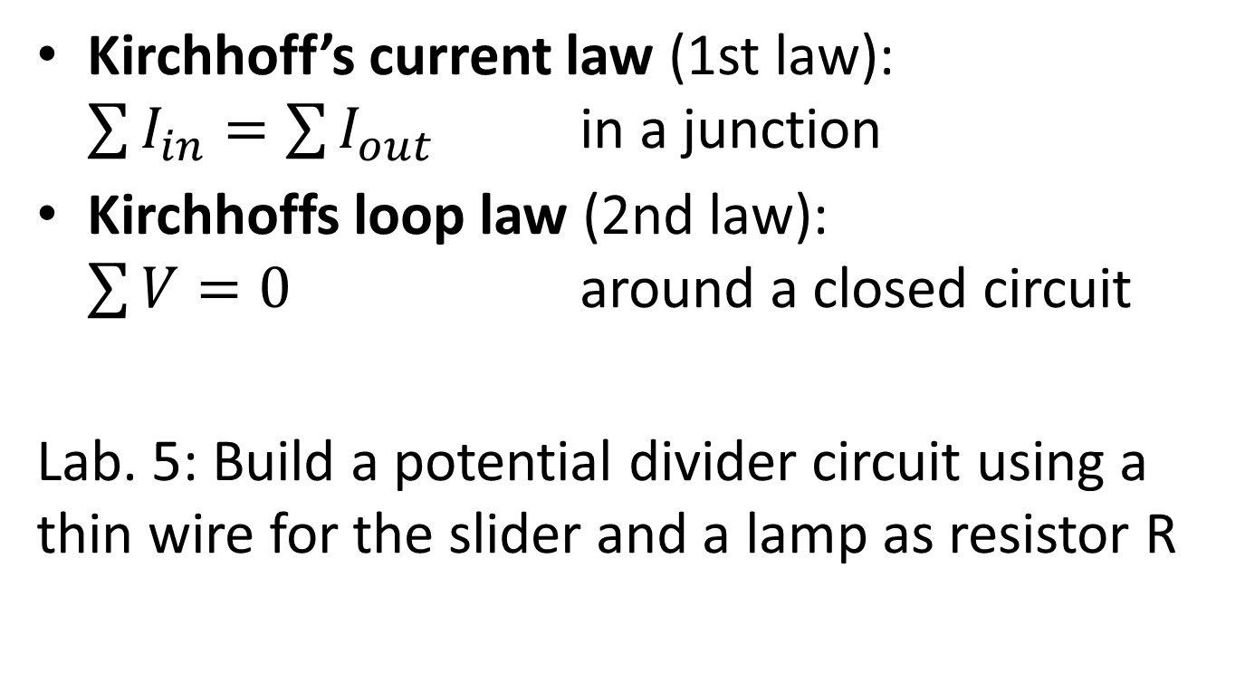
Kirchhoff’s current law (1st law):
$\sum{I_{in}=\sum{I_{out}}}$ in a junction
Kirchhoffs loop law (2nd law):
$\sum{V=0}$ around a closed circuit
Lab. 5: Build a potential divider circuit using a thin wire for the slider and a lamp as resistor R

