Slide 1
6.1 Electric fields
 | Electricity | Gravitation

Slide 2
6.1 Electric fields
 | Electricity | Gravitation
Property of matter | Charge (Q) in Coulomb (C) | Mass (m) in kilogram (kg)

Slide 3
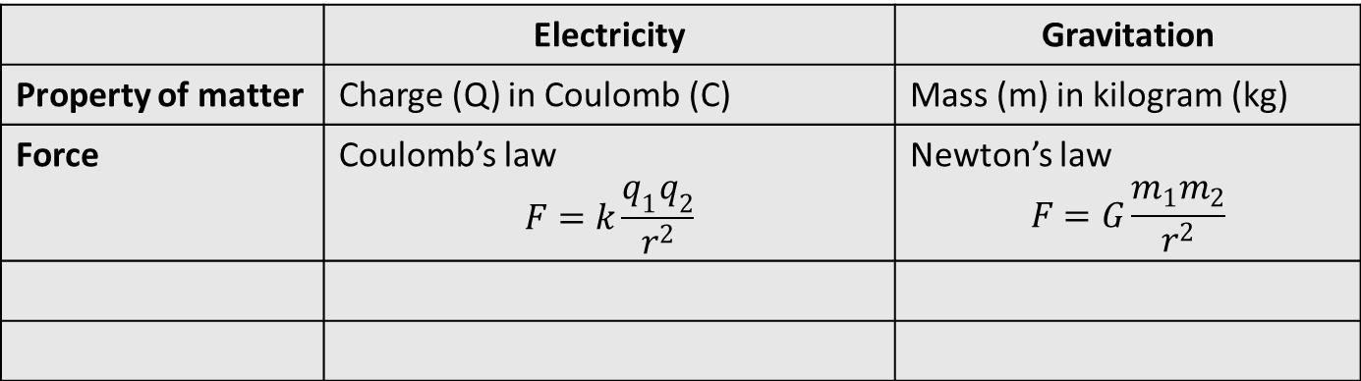
6.1 Electric fields
 | Electricity | Gravitation
Property of matter | Charge (Q) in Coulomb (C) | Mass (m) in kilogram (kg)
Force | Coulomb’s law $$F=k\frac{q_{1}q_{2}}{r^{2}}$$ | Newton’s law $$F=G\frac{m_{1}m_{2}}{r^{2}}$$

Slide 4
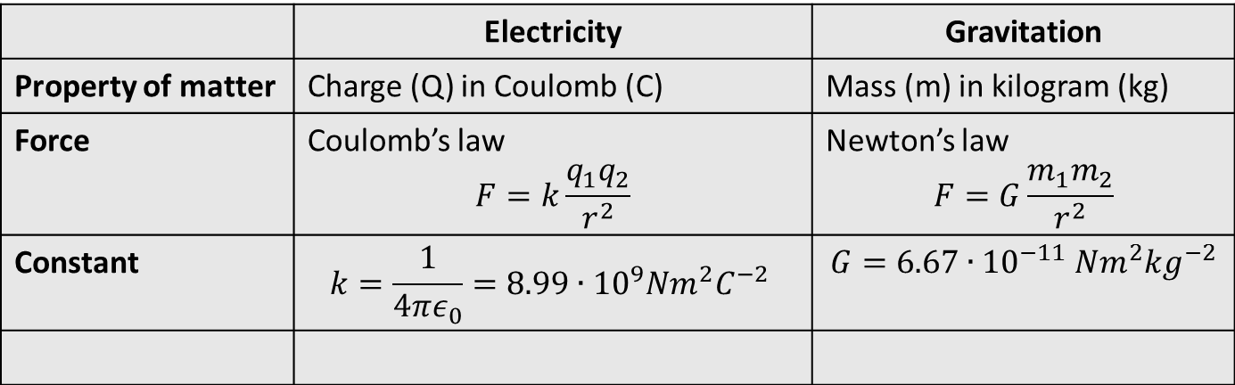
6.1 Electric fields
 | Electricity | Gravitation
Property of matter | Charge (Q) in Coulomb (C) | Mass (m) in kilogram (kg)
Force | Coulomb’s law $$F=k\frac{q_{1}q_{2}}{r^{2}}$$ | Newton’s law $$F=G\frac{m_{1}m_{2}}{r^{2}}$$
Constant | $$k=\frac{1}{4πε_{0}}=8.99∙{10}^{9}Nm^{2}C^{−2}$$ | $$G=6.67∙{10}^{−11} Nm^{2}kg^{−2}$$

Slide 5
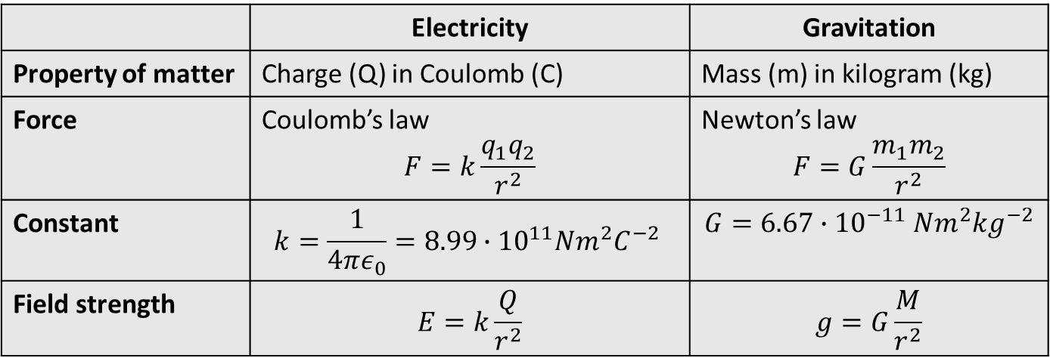
6.1 Electric fields
 | Electricity | Gravitation
Property of matter | Charge (Q) in Coulomb (C) | Mass (m) in kilogram (kg)
Force | Coulomb’s law $$F=k\frac{q_{1}q_{2}}{r^{2}}$$ | Newton’s law $$F=G\frac{m_{1}m_{2}}{r^{2}}$$
Constant | $$k=\frac{1}{4πε_{0}}=8.99∙{10}^{11}Nm^{2}C^{−2}$$ | $$G=6.67∙{10}^{−11} Nm^{2}kg^{−2}$$
Field strength | $$E=k\frac{Q}{r^{2}}$$ | $$g=G\frac{M}{r^{2}}$$

Slide 6
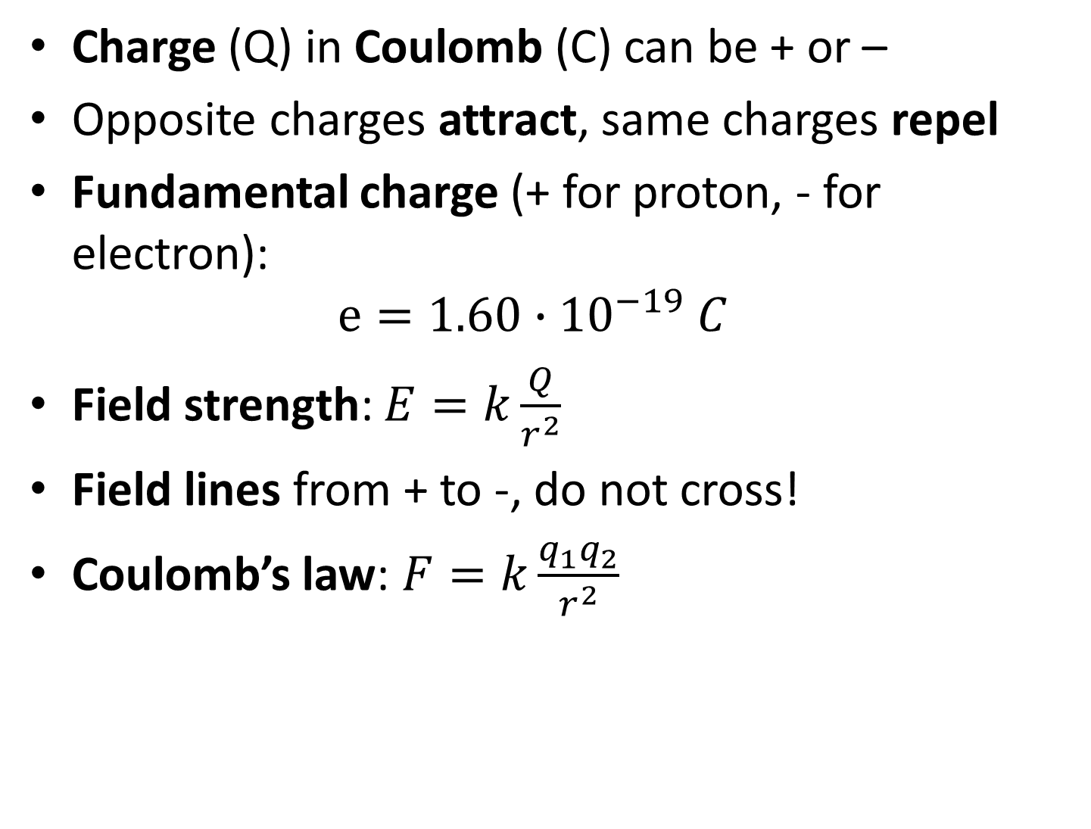
Charge (Q) in Coulomb (C) can be + or –
Opposite charges attract, same charges repel
Fundamental charge (+ for proton, - for electron):
$e=1.60∙{10}^{−19} C$
Field strength: $E=k\frac{Q}{r^{2}}$
Field lines from + to -, do not cross!
Coulomb’s law: $F=k\frac{q_{1}q_{2}}{r^{2}}$

Slide 7
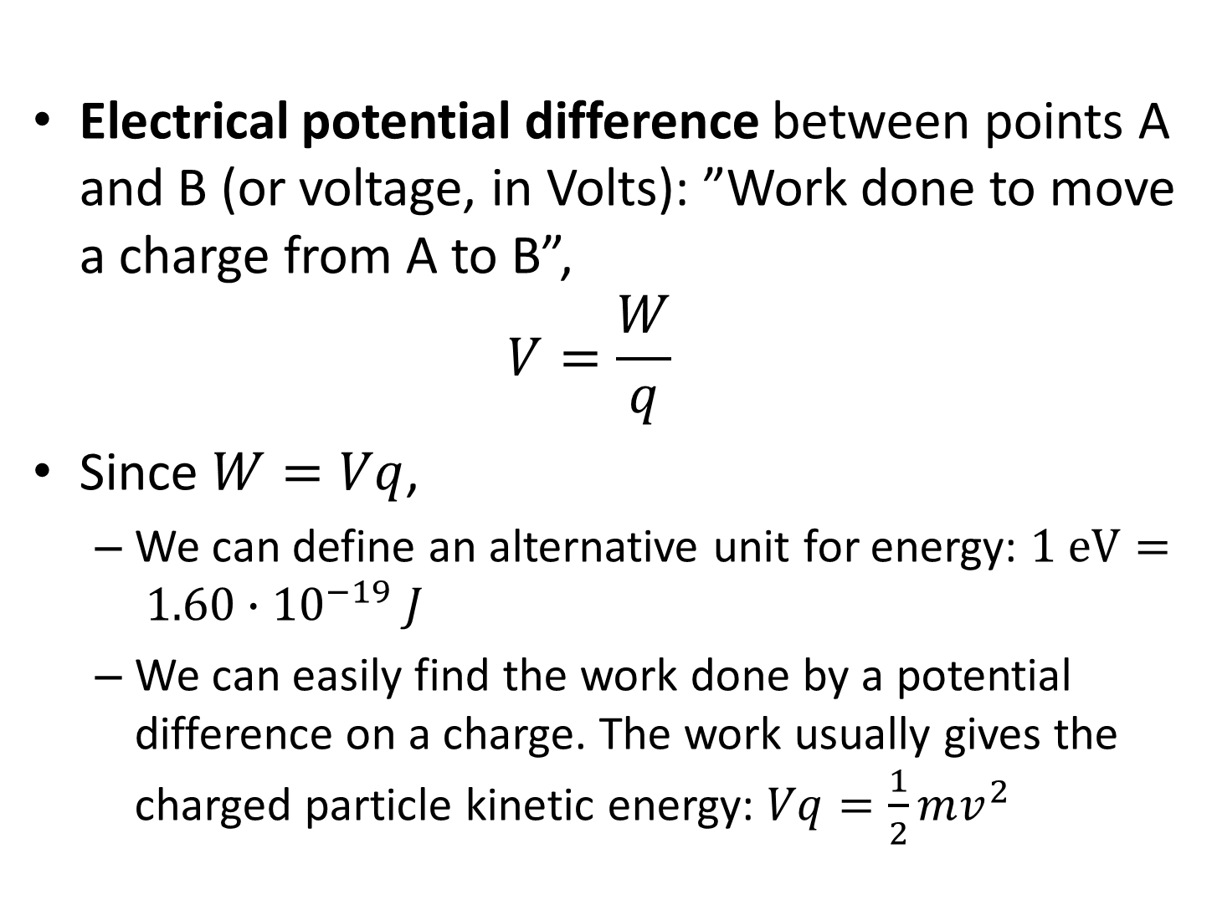
Electrical potential difference between points A and B (or voltage, in Volts): ”Work done to move a charge from A to B”,
$V=\frac{W}{q}$
Since $W=Vq$,
  We can define an alternative unit for energy: $1 eV= 1.60∙{10}^{−19} J$
  We can easily find the work done by a potential difference on a charge. The work usually gives the charged particle kinetic energy: $Vq=\frac{1}{2}mv^{2}$

Slide 8
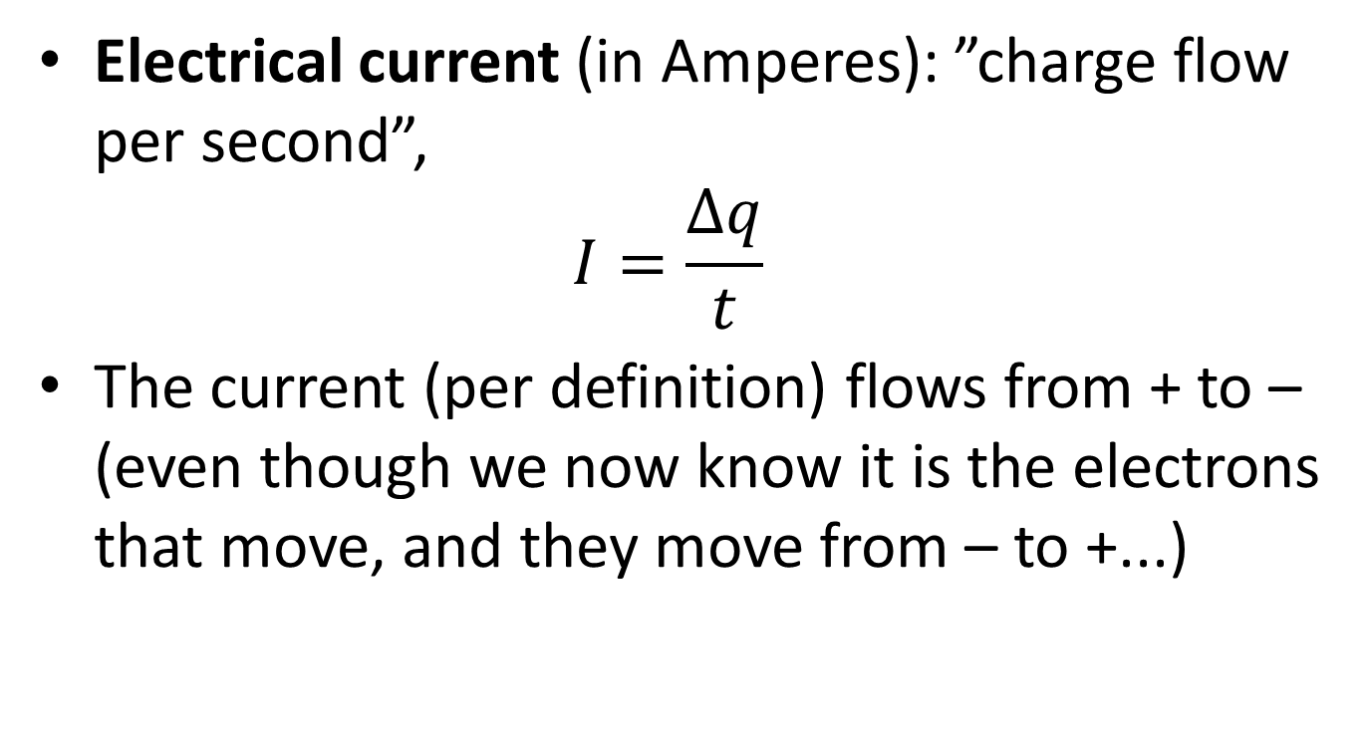
Electrical current (in Amperes): ”charge flow per second”,
$I=\frac{∆q}{t}$
The current (per definition) flows from + to – (even though we now know it is the electrons that move, and they move from – to +...)

