Slide 1
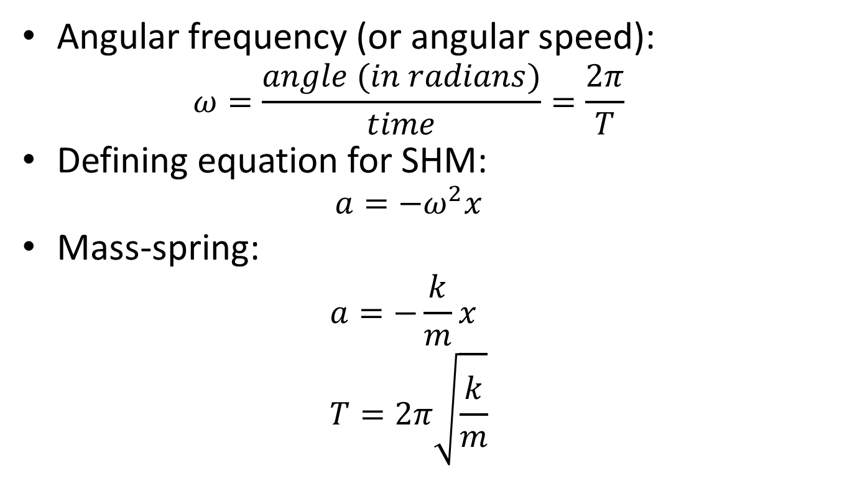
SHM
Angular frequency (or angular speed):
  $$ω=\frac{angle (in radians)}{time}=\frac{2π}{T}$$
Defining equation for SHM:
  $$a=−ω^{2}x$$
Mass-spring:
  $$a=−\frac{k}{m}x \\ T=2π\sqrt{\frac{k}{m}}$$

Slide 2
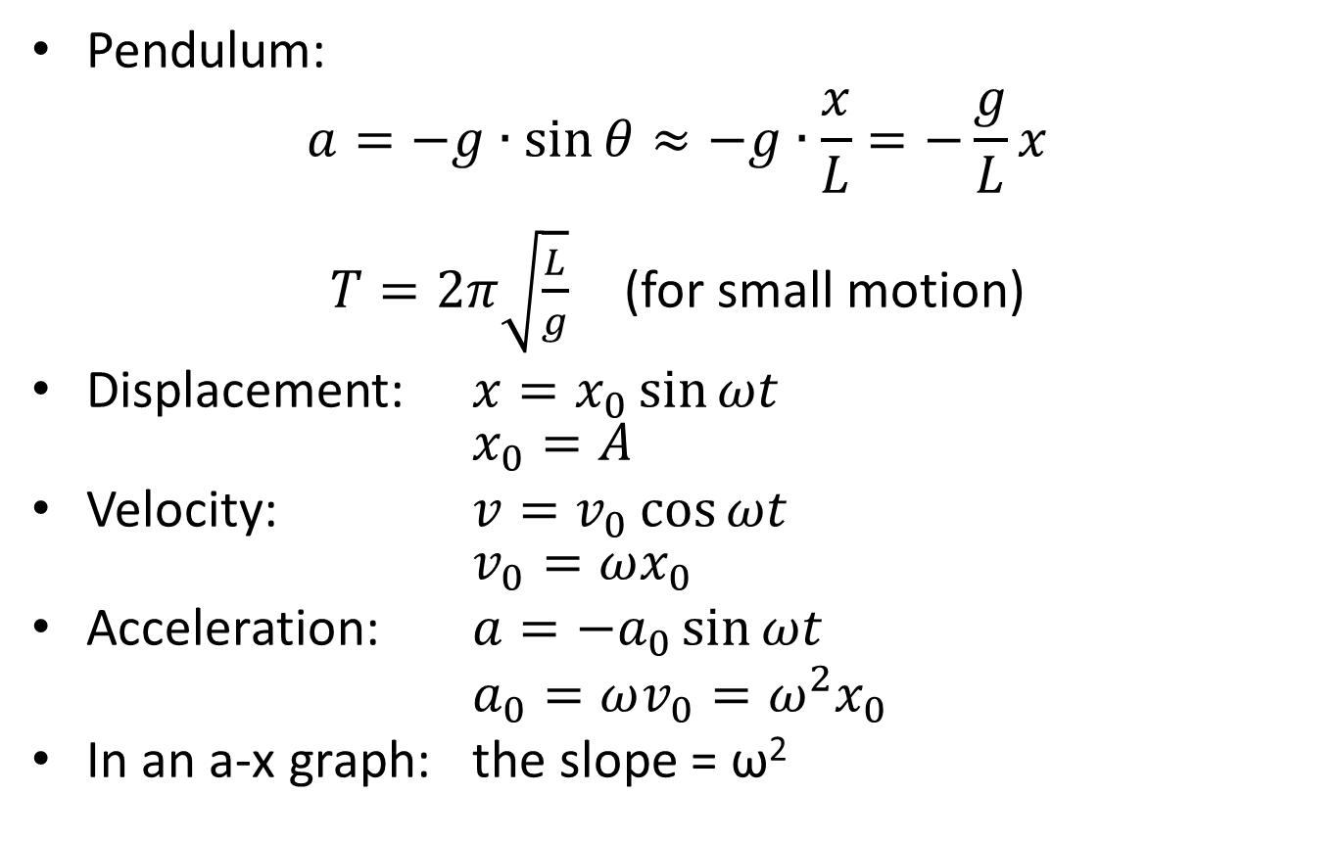
Pendulum:
$$a=−g∙\sin{θ}≈−g∙\frac{x}{L}=−\frac{g}{L}x$$
$T=2π\sqrt{\frac{L}{g}}$ (for small motion)
Displacement: $x=x_{0}\sin{ωt}$
$x_{0}=A$
Velocity: $v=v_{0}\cos{ωt}$
$v_{0}=ωx_{0}$
Acceleration: $a={−a}_{0}\sin{ωt}$
$a_{0}=ωv_{0}=ω^{2}x_{0}$
In an a-x graph: the slope = ω²

Slide 3
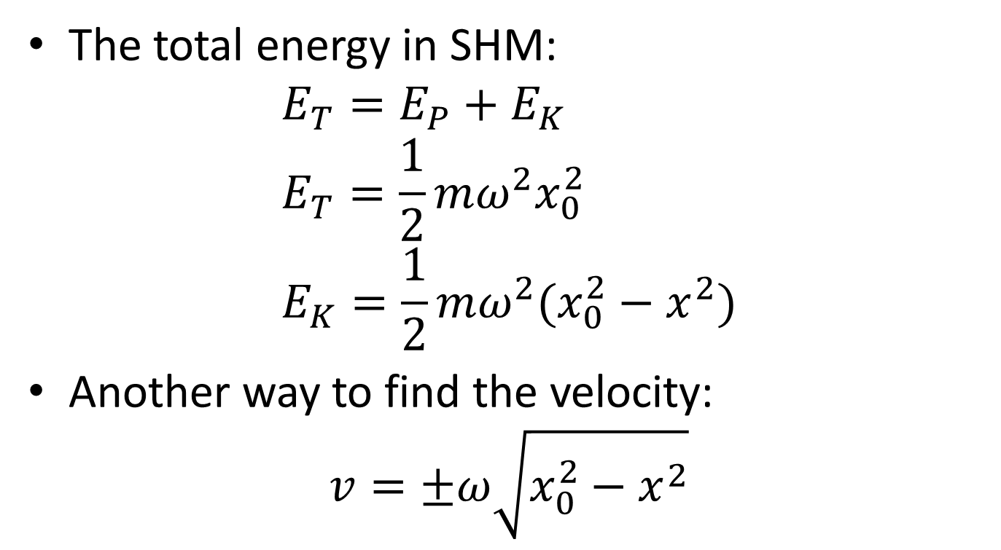
The total energy in SHM:
$$E_{T}=E_{P}+E_{K} \\ E_{T}=\frac{1}{2}mω^{2}x_{0}^{2} \\ E_{K}=\frac{1}{2}mω^{2}(x_{0}^{2}−x^{2})$$
Another way to find the velocity:
$$v=±ω\sqrt{x_{0}^{2}−x^{2}}$$

Slide 4
Single slit diffraction
Diffraction: waves bend around corners
Interference: the bent waves will meet and in some places enhance or cancel each other

Slide 5
Screen
Single slit
b

Slide 6
Screen
Single slit
One half wavelength gives destructive interference
b
θ

Slide 7
Screen
Single slit
One half wavelength gives destructive interference
b
b
θ

Slide 8
Screen
Single slit
One half wavelength gives destructive interference
b
θ

Slide 9
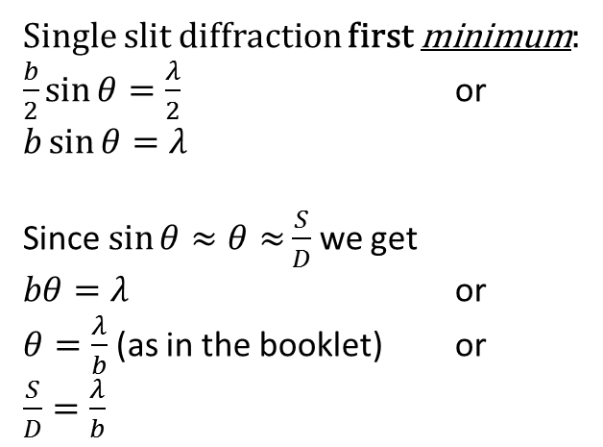
Screen
Single slit
One half wavelength gives destructive interference
b
S
θ
D
b/2
Single slit diffraction first minimum:
$\frac{b}{2}\sin{θ=\frac{λ}{2}}$ or
$b\sin{θ=λ}$
Since $\sin{θ≈θ≈}\frac{S}{D}$ we get
$bθ=λ$ or
$θ=\frac{λ}{b}$ (as in the booklet) or
$\frac{S}{D}=\frac{λ}{b}$
θ
λ/2

Slide 10
Double slit and multiple slits
For a double slit with very very very small openings:

Slide 11
Screen
Double slit
d
Same path lenght
gives constructive interference
which gives a bright spot in the middle

Slide 12
Screen
Double slit
One half wavelength gives destructive interference = dark spot
d

Slide 13
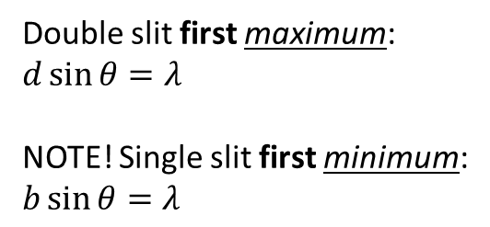
Screen
Double slit
One full wavelength gives constructive interference = bright spot
d
θ
θ
Double slit first maximum:
$d\sin{θ=λ}$
NOTE! Single slit first minimum:
$b\sin{θ=λ}$

Slide 14
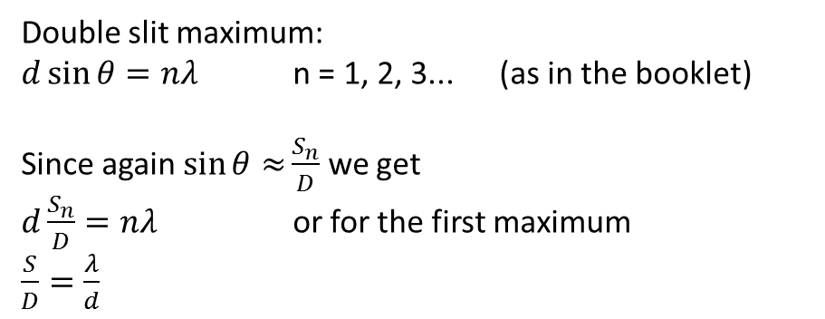
Screen
Double slit
Two full wavelengths give constructive interference = bright spot
S_{n}
d
D
Double slit maximum:
$d\sin{θ=nλ}$ n = 1, 2, 3... (as in the booklet)
Since again $\sin{θ≈}\frac{S_{n}}{D}$ we get
$d\frac{S_{n}}{D}=nλ$ or for the first maximum
$\frac{S}{D}=\frac{λ}{d}$

Slide 15
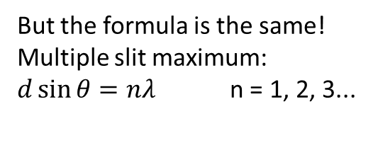
Screen
Multiple slit
The more slits you have,
the narrower and brighter the bright spots become!
d
Many slits together are called a grating.
But the formula is the same!
Multiple slit maximum:
$d\sin{θ=nλ}$ n = 1, 2, 3...

Slide 16
Screen
Double slit
If the width of the openings are not very very small, you will get a combination of single-slit and double-slit patterns!
d
b

Slide 17
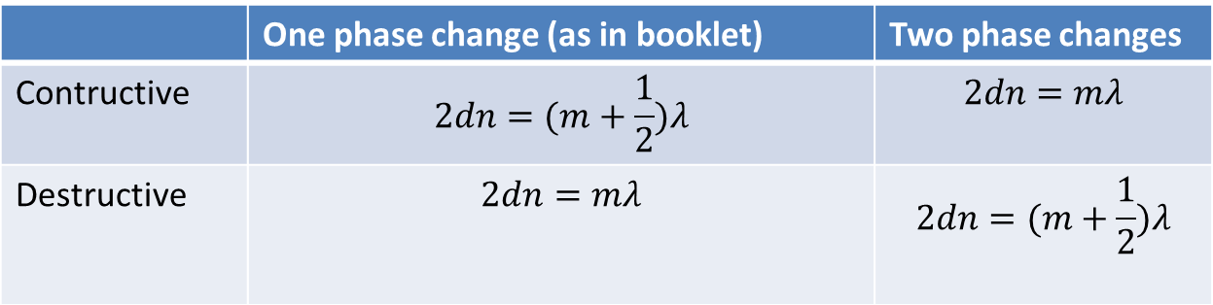
Thin film interference
  There is always both reflection and refraction when light passes from one medium to another
  Light waves change phase when reflecting off a medium of higher refractive index
  If we can make destructive interference happen less light will be reflected (used e.g. in camera lenses and solar cells)
 | One phase change (as in booklet) | Two phase changes
Contructive | $$2dn=(m+\frac{1}{2})λ$$ | $$2dn=mλ$$
Destructive | $$2dn=mλ$$ | $$2dn=(m+\frac{1}{2})λ$$

Slide 18
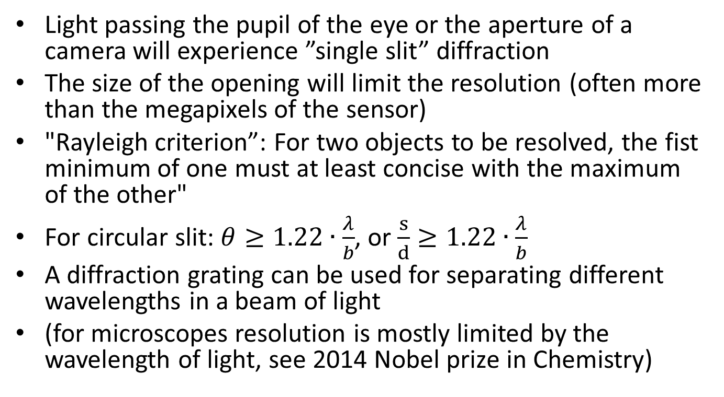
Resolution
Light passing the pupil of the eye or the aperture of a camera will experience ”single slit” diffraction
The size of the opening will limit the resolution (often more than the megapixels of the sensor)
"Rayleigh criterion”: For two objects to be resolved, the fist minimum of one must at least concise with the maximum of the other"
For circular slit: $θ≥1.22∙\frac{λ}{b}$, or $\frac{s}{d}≥1.22∙\frac{λ}{b}$
A diffraction grating can be used for separating different wavelengths in a beam of light
(for microscopes resolution is mostly limited by the wavelength of light, see 2014 Nobel prize in Chemistry)

Slide 19
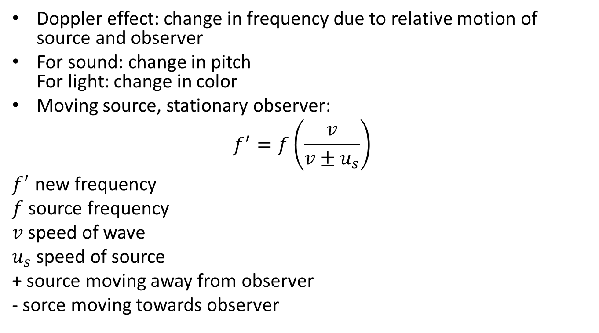
Doppler effect
Doppler effect: change in frequency due to relative motion of source and observer
For sound: change in pitch
For light: change in color
Moving source, stationary observer:
$$f^{′}=f\left(\frac{v}{v±u_{s}}\right)$$
$f^{′}$ new frequency
$f$ source frequency
$v$ speed of wave
$u_{s}$ speed of source
+ source moving away from observer
- sorce moving towards observer

Slide 20

Ex.: An ambulance (v = 28 m s⁻¹, f = 1250 Hz) passes an observer. Calculate f and λ experineced by the observer
a) as ambulance approaches. b) as ambulance moves away.
$$f^{′}=f\left(\frac{v}{v±u_{s}}\right)$$

Slide 21
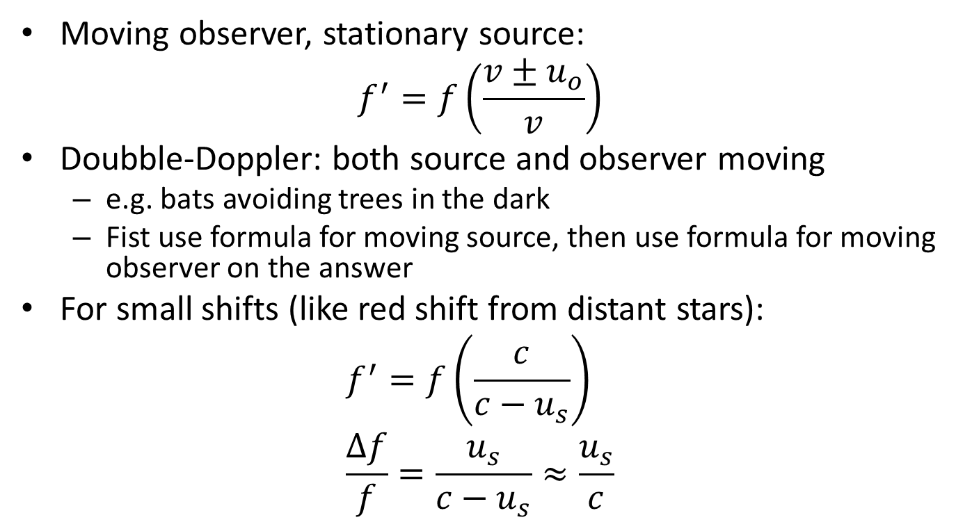
Moving observer, stationary source:
$$f^{′}=f\left(\frac{v±u_{o}}{v}\right)$$
Doubble-Doppler: both source and observer moving
  e.g. bats avoiding trees in the dark
  Fist use formula for moving source, then use formula for moving observer on the answer
For small shifts (like red shift from distant stars):
$$f^{′}=f\left(\frac{c}{c−u_{s}}\right) \\ \frac{∆f}{f}=\frac{u_{s}}{c−u_{s}}≈\frac{u_{s}}{c}$$

Slide 22
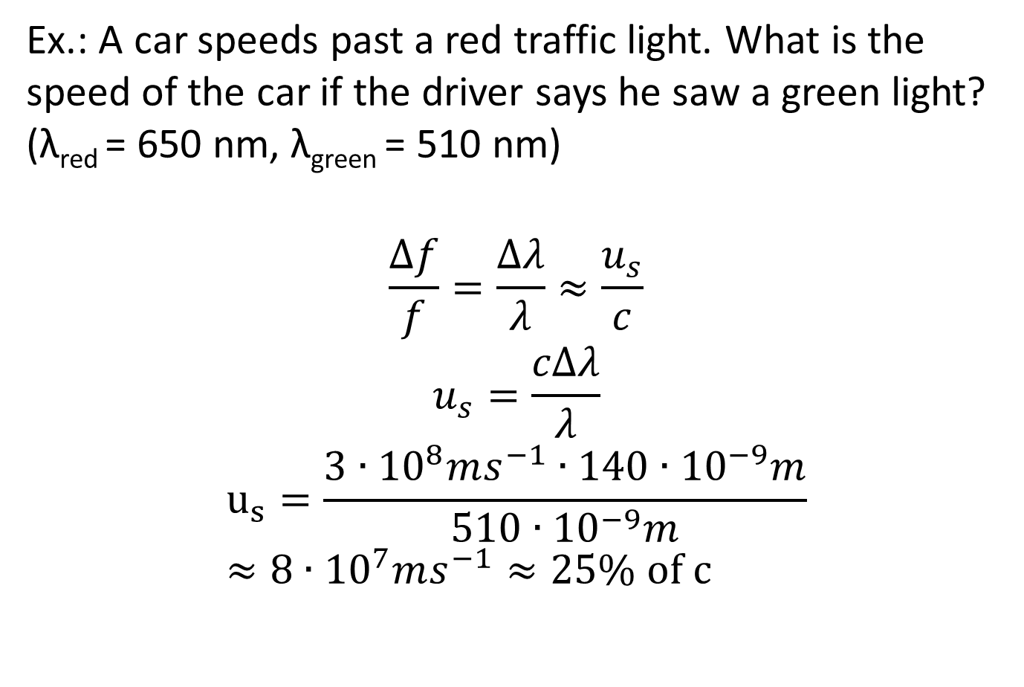
Ex.: A car speeds past a red traffic light. What is the speed of the car if the driver says he saw a green light? (λ_{red} = 650 nm, λ_{green} = 510 nm)
$$\frac{∆f}{f}=\frac{Δλ}{λ}≈\frac{u_{s}}{c}$$
$$u_{s}=\frac{cΔλ}{λ}$$
$$u_{s}=\frac{3∙{10}^{8}ms^{−1}∙140∙{10}^{−9}m}{510∙{10}^{−9}m} \\ ≈8∙{10}^{7}ms^{−1}≈25\% of c$$

