Slide 1
9.2 Single-slit diffraction

Slide 2
Diffraction through a single-slit
•If a wave meets a hole in a wall that is of comparable size to its wavelength, the wave will be bent through a process called diffraction.
•If the aperture (hole, opening, etc.) is much larger than the wavelength, diffraction will be minimal to nonexistent.
DIFFRACTED WAVE
INCIDENT WAVE
Notes:
© 2015 By Timothy K. Lund

Slide 3
Huygens’ principle
•Christiaan Huygens explained the behavior of diffraction through his famous principle:
“Every point on a wave front emits a spherical
wavelet of the same velocity and wavelength
as the original wave.”
•Huygens’ principle explains why
waves can turn corners.
Notes:
© 2015 By Timothy K. Lund

Slide 4
Huygens’ principle and diffraction through a single-slit
•The reason waves can turn corners is that the incoming wave transmits a disturbance by causing the medium to vibrate.
•Wherever the medium vibrates it becomes the center of a new wave front
•Note that the smaller the aperture b
the more pronounced the diffraction
effect.
b₁
b₂
b₃
•The aperture size must be of the order of a wavelength in order for diffraction to occur.
b₃= 2λ
b₂= 6λ
b₁= 12λ
Notes:
© 2015 By Timothy K. Lund

Slide 5
Interference and path difference
•The condition for constructive interference is
path difference = nλ (where n is an integer)
P₂
L₁ = 4λ
L₂ = 3λ
P₁
L₁ = 4λ
L₂ = 2λ
S₁
S₂
Notes:
© 2015 By Timothy K. Lund

Slide 6
Interference and path difference
•The condition for destructive interference is
path difference = (n + ½)λ (where n is an integer)
P₄
L₂ = 4λ
P₃
L₁ = 3.5λ
L₁ = 3λ
L₂ = 2.5λ
S₁
S₂
Notes:
© 2015 By Timothy K. Lund

Slide 7
Diffraction through a single-slit
•Huygens’ wavelets not only
allow the wave to turn
corners, they also
interfere with each other.
Constructive interference
RELATIVE INTENSITY
Destructive interference
Notes:
© 2015 By Timothy K. Lund

Slide 8

Derivation of the formula θ = λ / b
•Consider a single slit of width b.
•From Huygens we know that every point within the slit acts as a new wavelet.
•At the central maximum we see that the distance traveled by all the wavelets is about equal, and thus has constructive interference.
•Consider slit points x at one edge and y at the center:
At the 1st minimum, the difference in distance (blue and red dashed) must be λ / 2. Why?
x
1st min →
b
y
Notes:
© 2015 By Timothy K. Lund

Slide 9
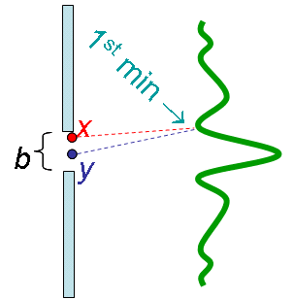
Derivation of the formula θ = λ / b
•We will choose the midpoint of the slit (y) as our reference.
•We will call the angle between the reference and the first minimum θ.
•We construct a right triangle as follows:
θ
x
b
2
θ
θ
y
λ
2
Notes:
© 2015 By Timothy K. Lund

Slide 10
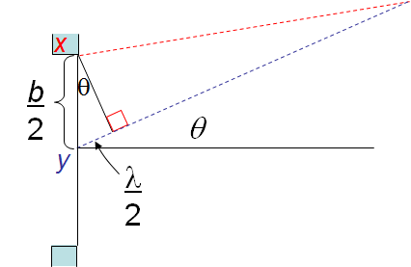
Derivation of the formula θ = λ / b
•From the right triangle we see that
sin θ = (λ / 2) / (b / 2)
sin θ = λ / b
•If θ is very small (and in radians) then
sin θ ≈ θ (θ in radians).
location of first minimum in single slit diffraction
θ = λ / b
(θ in radians)
Notes:
© 2015 By Timothy K. Lund

Slide 11
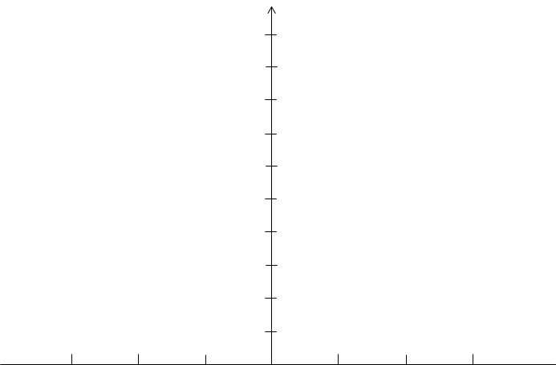
Intensity of a single-slit diffraction pattern
•The relative intensities of the maximums in the diffraction pattern are shown in the graph.
•The positioning of the minimums in the diffraction pattern are also shown in the graph.
I
I₀
I₀ / 20
I₀ / 50
I₀ / 100
λ
b
2λ
b
3λ
b
θ
Notes:
© 2015 By Timothy K. Lund

Slide 12



Shape of a single-slit diffraction pattern – change b
•The shape of the diffraction pattern depends on the ratio of the slit width b to the wavelength λ.
• Since θ = λ / b we know that the bigger b is, the closer together the maximums and minimums will be.
I
b = λ
b = 5λ
θ
b = 10λ
monochrome, change b only
Notes:
© 2015 By Timothy K. Lund

Slide 13



Shape of a single-slit diffraction pattern – change λ
•Since θ = λ / b we know that the smaller λ is, the closer together the maximums and minimums will be.
I
θ
change λ only
Notes:
© 2015 By Timothy K. Lund

Slide 14
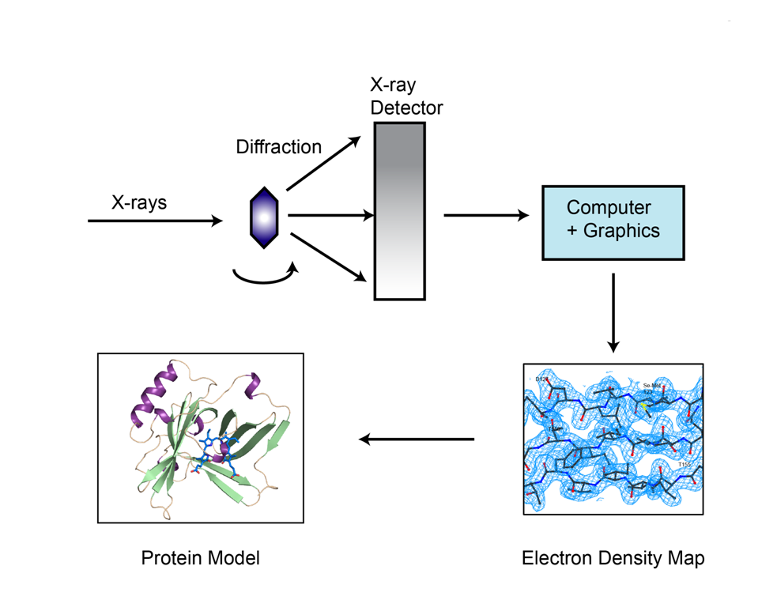
Utilization of diffraction
X-ray crystallography
  a technique to determine the atomic/molecular structure of a crystal
Lens diffraction in photography
  the larger the f-number, the more blur you get

