Slide 1
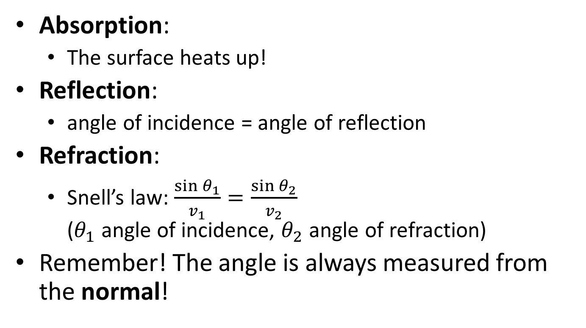
5.3 2D waves
Absorption:
  The surface heats up!
Reflection:
  angle of incidence = angle of reflection
Refraction:
  Snell’s law: $\frac{\sin{θ_{1}}}{v_{1}}=\frac{\sin{θ_{2}}}{v_{2}}$
  ($θ_{1}$ angle of incidence, $θ_{2}$ angle of refraction)
Remember! The angle is always measured from the normal!

Slide 2
Diffraction:
  Waves bend around corners!
  The wavelength must be of similar size as the opening
Double source interference:
  Waves from two sources will sometimes add (positive interference) and sometimes cancel (negative interference)

