Slide 1
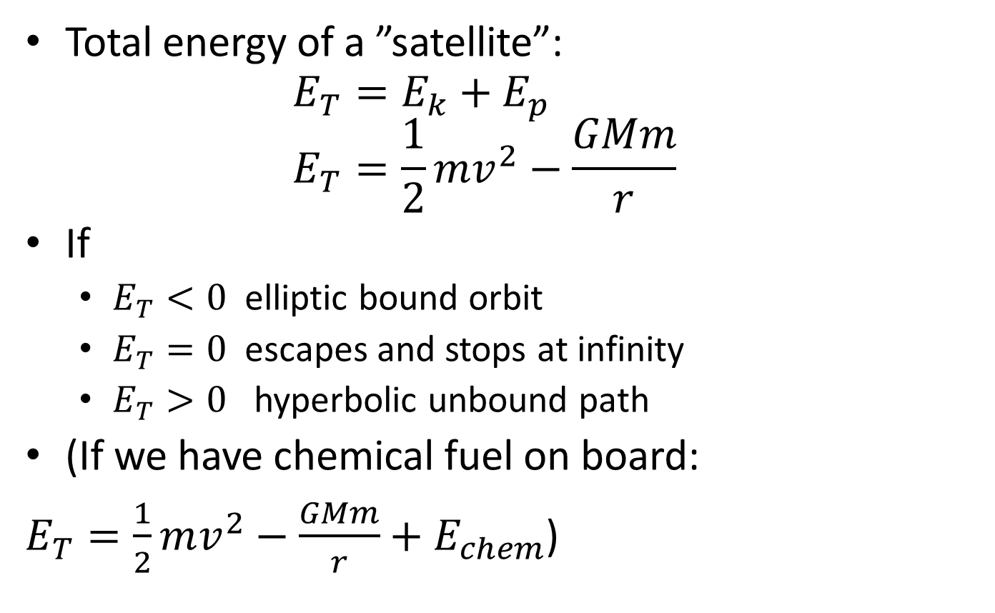
4.2 Fields at work (HL)
Total energy of a ”satellite”:
$E_{T}=E_{k}+E_{p}$
$E_{T}=\frac{1}{2}mv^{2}−\frac{GMm}{r}$
If
  $E_{T}<0$ elliptic bound orbit
  $E_{T}=0$ escapes and stops at infinity
  $E_{T}>0$ hyperbolic unbound path
(If we have chemical fuel on board:
$E_{T}=\frac{1}{2}mv^{2}−\frac{GMm}{r}+E_{chem}$)

Slide 2
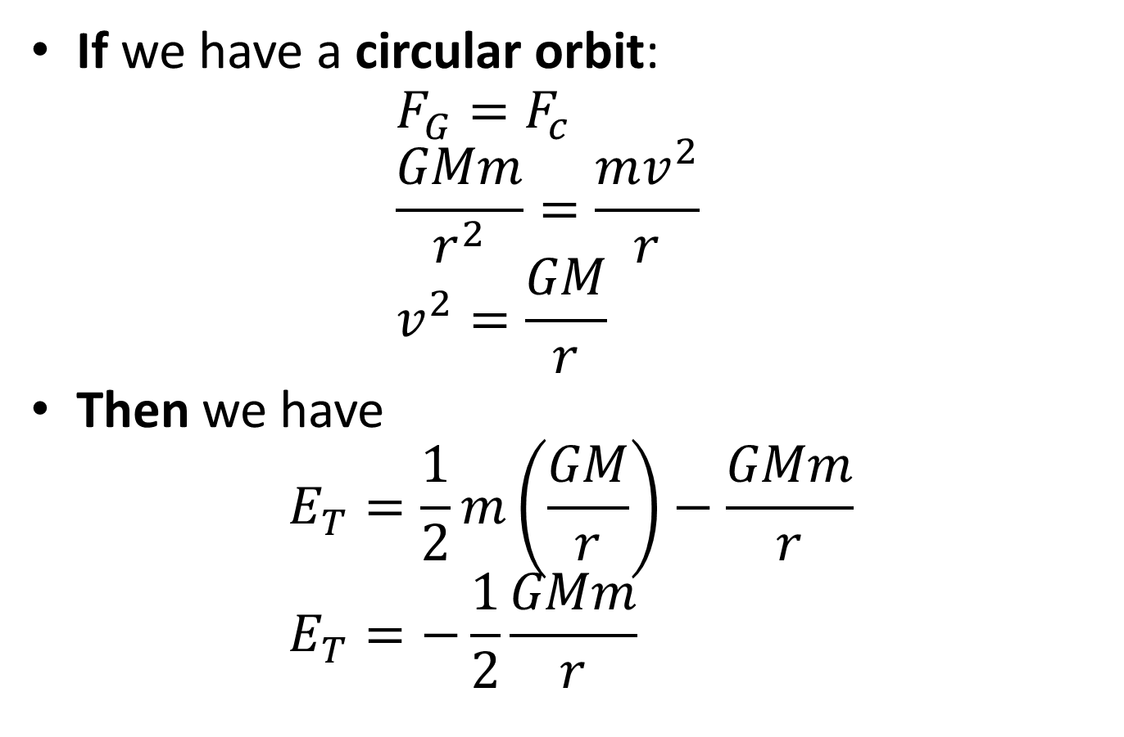
If we have a circular orbit:
$F_{G}=F_{c}$
$\frac{GMm}{r^{2}}=\frac{mv^{2}}{r}$
$v^{2}=\frac{GM}{r}$
Then we have
$E_{T}=\frac{1}{2}m\left(\frac{GM}{r}\right)−\frac{GMm}{r}$
$E_{T}=−\frac{1}{2}\frac{GMm}{r}$

Slide 3
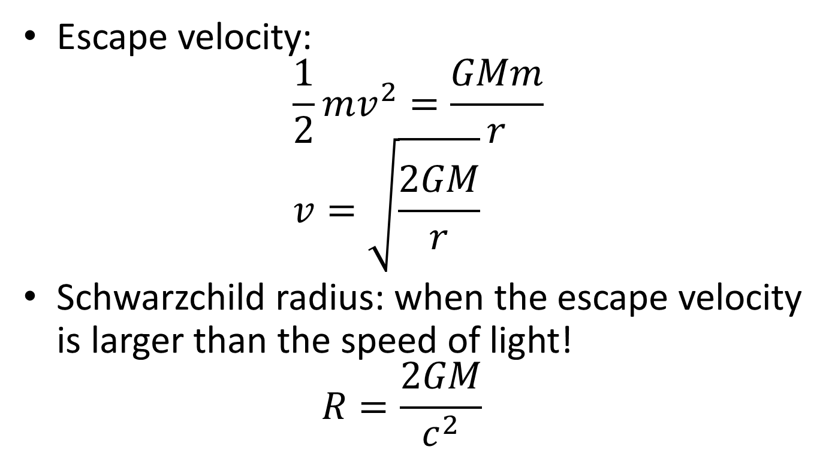
Escape velocity:
$\frac{1}{2}mv^{2}=\frac{GMm}{r}$
$v=\sqrt{\frac{2GM}{r}}$
Schwarzchild radius: when the escape velocity is larger than the speed of light!
$R=\frac{2GM}{c^{2}}$

