Slide 1
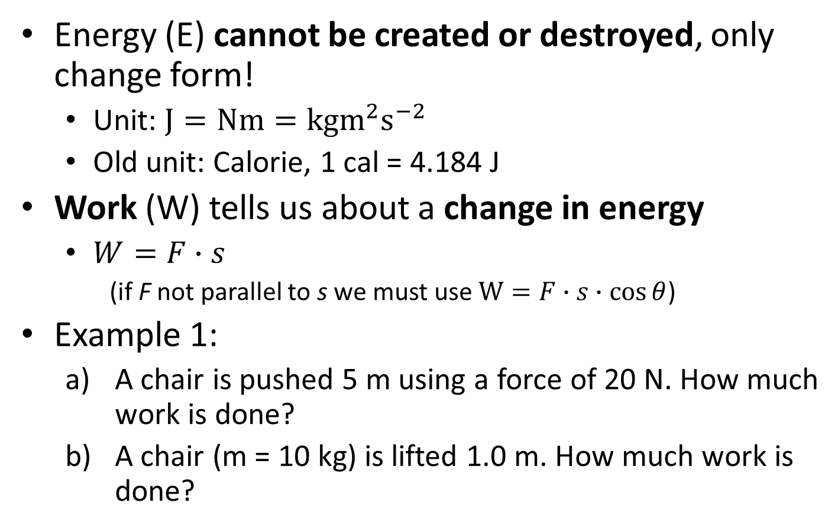
6. Work, potential energy, kinetic energy
Energy (E) cannot be created or destroyed, only change form!
  Unit: $J=Nm=kgm^{2}s^{−2}$
  Old unit: Calorie, 1 cal = 4.184 J
Work (W) tells us about a change in energy
  $W=F∙s$
    (if F not parallel to s we must use $W=F∙s∙\cos{θ}$)
Example 1:
  A chair is pushed 5 m using a force of 20 N. How much work is done?
  A chair (m = 10 kg) is lifted 1.0 m. How much work is done?

Slide 2
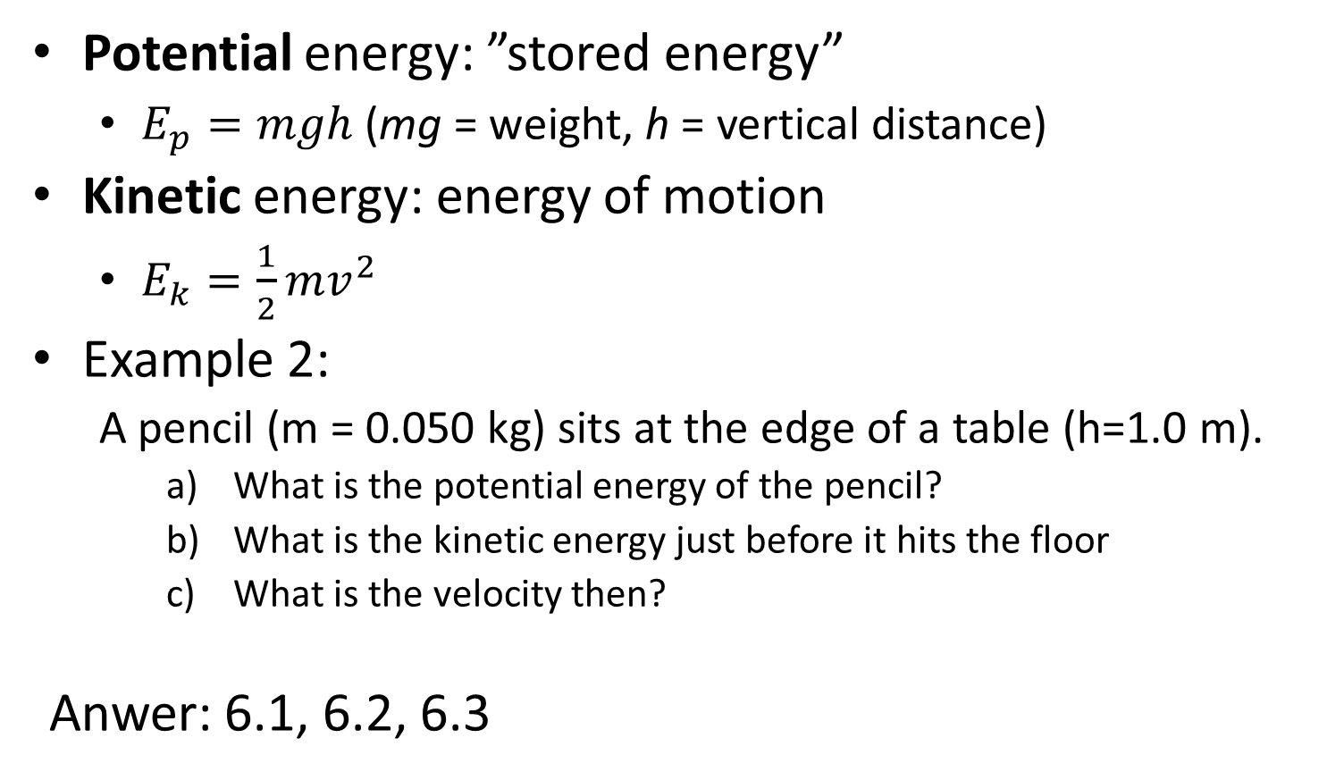
Potential energy: ”stored energy”
  $E_{p}=mgh$ (mg = weight, h = vertical distance)
Kinetic energy: energy of motion
  $E_{k}=\frac{1}{2}mv^{2}$
Example 2:
  A pencil (m = 0.050 kg) sits at the edge of a table (h=1.0 m).
    What is the potential energy of the pencil?
    What is the kinetic energy just before it hits the floor
    What is the velocity then?
Anwer: 6.1, 6.2, 6.3

