Slide 1
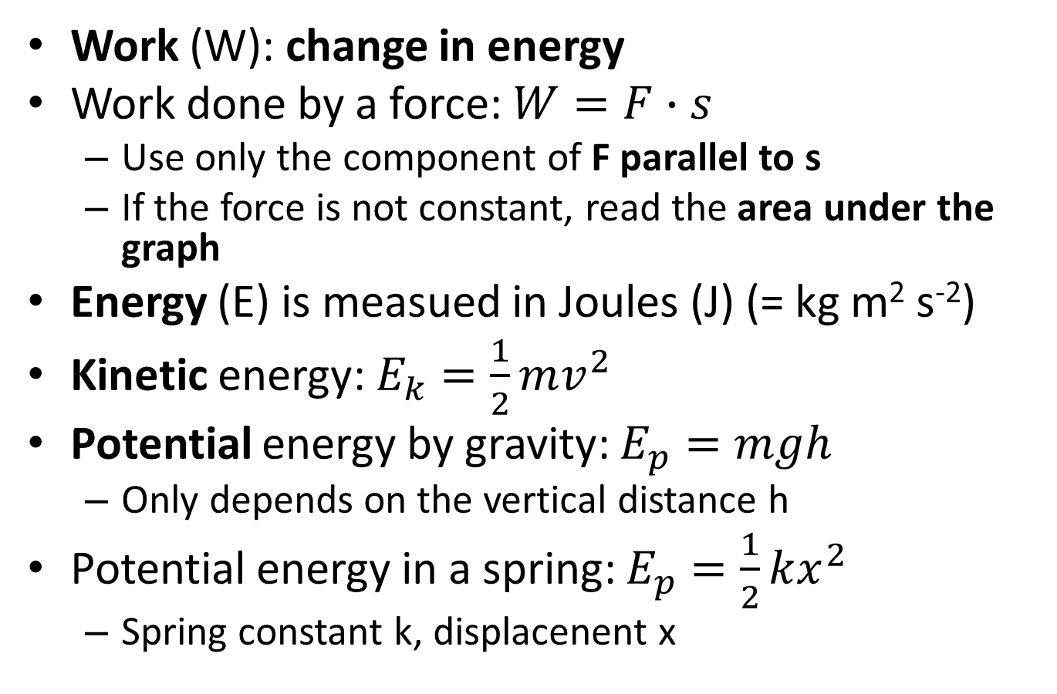
2.4 Work, energy, power
Work (W): change in energy
Work done by a force: $W=F∙s$
  Use only the component of F parallel to s
  If the force is not constant, read the area under the graph
Energy (E) is measued in Joules (J) (= kg m² s⁻²)
Kinetic energy: $E_{k}=\frac{1}{2}mv^{2}$
Potential energy by gravity: $E_{p}=mgh$
  Only depends on the vertical distance h
Potential energy in a spring: $E_{p}=\frac{1}{2}kx^{2}$
  Spring constant k, displacenent x

Slide 2
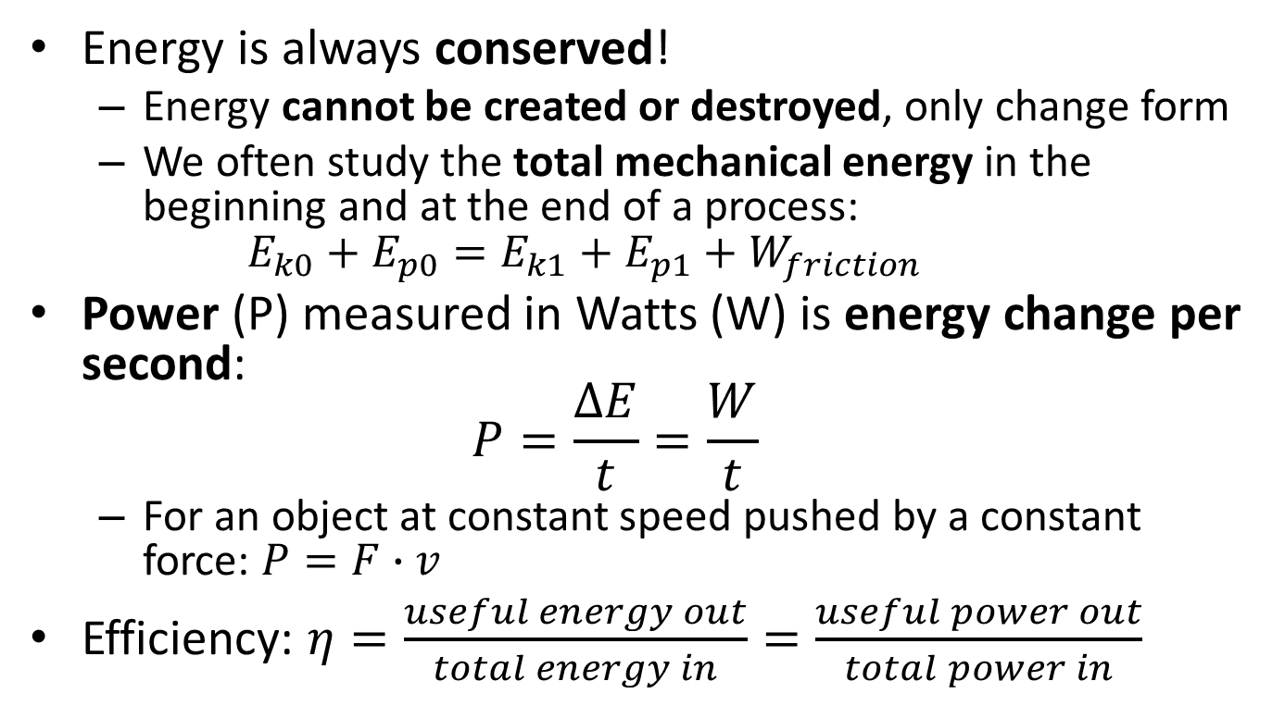
Energy is always conserved!
  Energy cannot be created or destroyed, only change form
  We often study the total mechanical energy in the beginning and at the end of a process:
  $E_{k0}+E_{p0}=E_{k1}+E_{p1}+W_{friction}$
Power (P) measured in Watts (W) is energy change per second:
$P=\frac{∆E}{t}=\frac{W}{t}$
  For an object at constant speed pushed by a constant force: $P=F∙v$
Efficiency: $η=\frac{useful energy out}{total energy in}=\frac{useful power out}{total power in}$

Slide 3
Ex. 1: A ball (m = 2.0 kg) is held 1.5 m above the floor
  What is the potential energy?
  If released, how much kinetic energy would it have just before hitting the floor?
  At what speed would it hit the floor?

Slide 4
Ex 2: A car (m = 1200 kg, u = 2.0 m s⁻¹) runs down a hill (12 m high, 85 m long) to reach v = 4.0 m s⁻¹. How big is the average force of friction?

