Slide 1
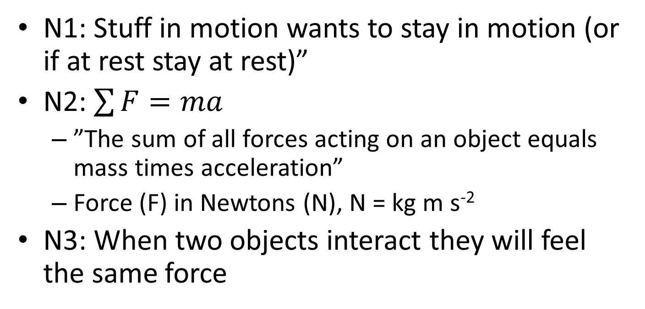
4 Newton’s laws of motion
N1: Stuff in motion wants to stay in motion (or if at rest stay at rest)”
N2: $\sum{F=ma}$
  ”The sum of all forces acting on an object equals mass times acceleration”
  Force (F) in Newtons (N), N = kg m s⁻²
N3: When two objects interact they will feel the same force

Slide 2
Mass (m) is measured in kg and is the same everywhere
Weight (W) is a force measured in Newtons and depends on what planet you are on
  W = mg
A ”free-body diagram” is a figure where all the forces acting on a specific body are drawn to scale

Slide 3
Draw a free-body diagram for
A book on a table
A chair pushed by a person
at constant speed
A skier accelerating down hill

Slide 4
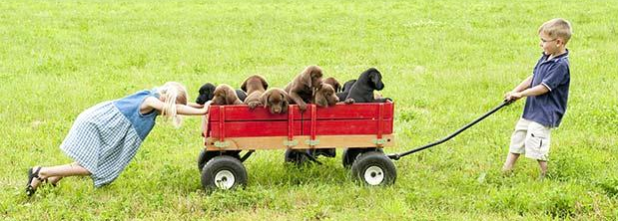
A wagon of puppies has the mass 35 kg. Peter pulls the wagon using 180 N and Lisa pushes the wagon using 230 N, while the grass resists the motion with 340 N. What will the acceleration of the wagon be?

Slide 5
Three tug boats move a ship at constant velocity. One pulls to the South (120 000 N) and a second one to the West (120 000 N). What is the size and direction of the third force?

