Slide 1
”Mathematics is the language of physics”

Slide 2
0. Solving for a variable
We solve equations whith only symbols using exactly the same rules as for normal equations!

Slide 3
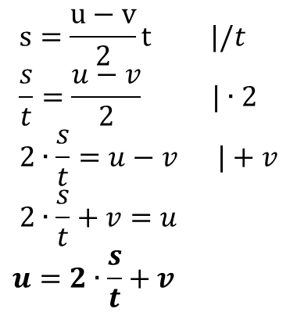
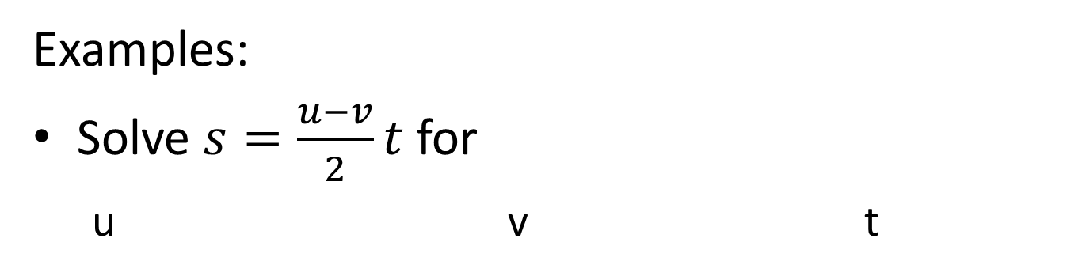
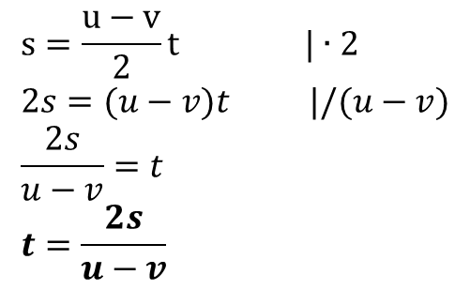
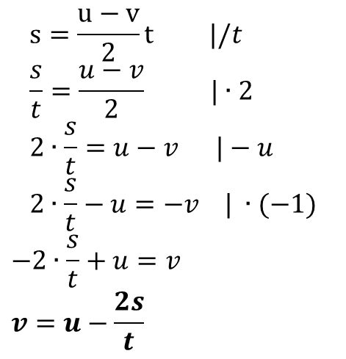
Examples:
Solve $s=\frac{u−v}{2}t$ for
  u v t
$$s=\frac{u−v}{2}t |/t \\ \frac{s}{t}=\frac{u−v}{2} |∙2 \\ 2∙\frac{s}{t}=u−v |+v \\ 2∙\frac{s}{t}+v=u$$
$$u=2∙\frac{s}{t}+v$$
$$s=\frac{u−v}{2}t |/t \\ \frac{s}{t}=\frac{u−v}{2} |∙2 \\ 2∙\frac{s}{t}=u−v |−u \\ 2∙\frac{s}{t}−u=−v | ∙(−1)$$
$$−2∙\frac{s}{t}+u=v \\ v=u−\frac{2s}{t}$$
$$s=\frac{u−v}{2}t |∙2 \\ 2s=(u−v)t |/(u−v) \\ \frac{2s}{u−v}=t \\ t=\frac{2s}{u−v}$$

Slide 4


Solve $v^{2}=u^{2}+2as$ for
  u a s
$$v^{2}=u^{2}+2as |−2as \\ v^{2}−2as=u^{2} \\ u^{2}=v^{2}−2as |\sqrt{} \\ u=\sqrt{v^{2}−2as}$$

Slide 5

Problems:
Solve $F=ma$ for
  m
  a
Solve $E_{k}=\frac{1}{2}mv^{2}$ for
  m
  v
Solve $\frac{1}{2}mv^{2}=mgh$ for
  v
  m
  h

