Slide 1
5. The structure of matter
Only 4 basic interactions!
  Gravity: between objects of mass
  Electromagnetic: ”everyting” else!
  Weak (nuclear): beta decay, neutrinos and other slow magic stuff
  Strong (nuclear): keeps the nucleus together
https://youtu.be/DZGINaRUEkU

Slide 2
The standard model:
  6 quarks
  6 leptons
  1-8 exchange particles for each basic interaction
  The Higgs to give the others mass

Slide 3
Standard model
Quarks |  | Leptons

Slide 4
Standard model
Quarks |  | Leptons
First generation
Up (u) | Down (d) | Electron (e) | Electron neutrino (υ_{e})

Slide 5
Standard model
Quarks |  | Leptons
First generation
Up (u) | Down (d) | Electron (e) | Electron neutrino (υ_{e})
Second generation
Strange (s) | Charm (c) | Myon (µ) | Myon neutrino (υ_{µ})

Slide 6
Standard model
Quarks |  | Leptons
First generation
Up (u) | Down (d) | Electron (e) | Electron neutrino (υ_{e})
Second generation
Strange (s) | Charm (c) | Myon (µ) | Myon neutrino (υ_{µ})
Third generation
Top/truth (t) | Bottom/ beauty (b) | Tau (τ) | Tau neutrino (υ_{τ})

Slide 7
Standard model
Quarks |  | Leptons
First generation
u u u u u u | d d d d d d | e e | υ_{e} υ_{e}
Second generation
s s s s s s | c c c c c c | µ µ | υ_{µ} υ_{µ}
Third generation
t t t t t t | b b b b b b | τ τ | υ_{τ} υ_{τ}
Gravity: Graviton?
EM Photon
Weak W⁺,W⁻, Z-bosons
Strong 8 gluons
Higgs: Mass

Slide 8
Atomic models:
  Electron discovered 1897 by J.J. Thomson
  Thomson model (”plum pudding”), positive sphere containing electrons
  Nucleus discovered 1911 by E. Rutherford
  Rutherford model (”planetary”), small positive nucleus orbited by electrons (physically impossible!)
  Bohr model 1913, electrons in certain orbits (physically impossible, but works for H!)
  Heisenberg/Schrödinger model 1926 (”electron cloud”), quantum mechanical probabilities
  Neutron discovered 1932 by J. Chadwick. Now all 3000 isotopes could be constructed using p,n,e. Simple and beatiful!
https://youtu.be/thnDxFdkzZs

Slide 9
Atoms
Our ordinary picture of an
atom is useful (but very wrong)
 | Charge | Mass | Size | Nucleon | Decides the element
Proton | + | tiny | tiny | yes | Yes
Neutron | no | tiny | tiny | yes | no
Electron | - | 0.0001 ∙ tiny | probably 0 | no | no

Slide 10

Representation:
Atoms of the same element (number of protons) but different number of neutrons are called isotopes
Only certain combinations of neutrons and protons are stable
  117 known elements
  80 elements have at lest one stable isotope
  254 stable isotopes in total
  about 3000 unstable isotopes known
Mass number (nucleon number)
$${}_{3}^{7}{Li}$$
Symbol of element
Atomic number (proton number)

Slide 11
Using phet build an atom
  Build a stable neutral atom with 4 protons
  Build a stable neutral atom with 6 neutrons
  Build an ion with 6 electrons
  Find 2 elements with 3 stable isotopes

Slide 12
Radiation
Electromagnetic radiation: a wave phenomenon with different properties (and names) depending on the wavelenght
  Radio waves
  Microwaves
  Infrared radiation
  Visible light
  Ultraviolet light, UV (often divided into UVA, UVB, UVC)
  X-rays
  Gamma rays
Particle radiation: particles at high speed

Slide 14
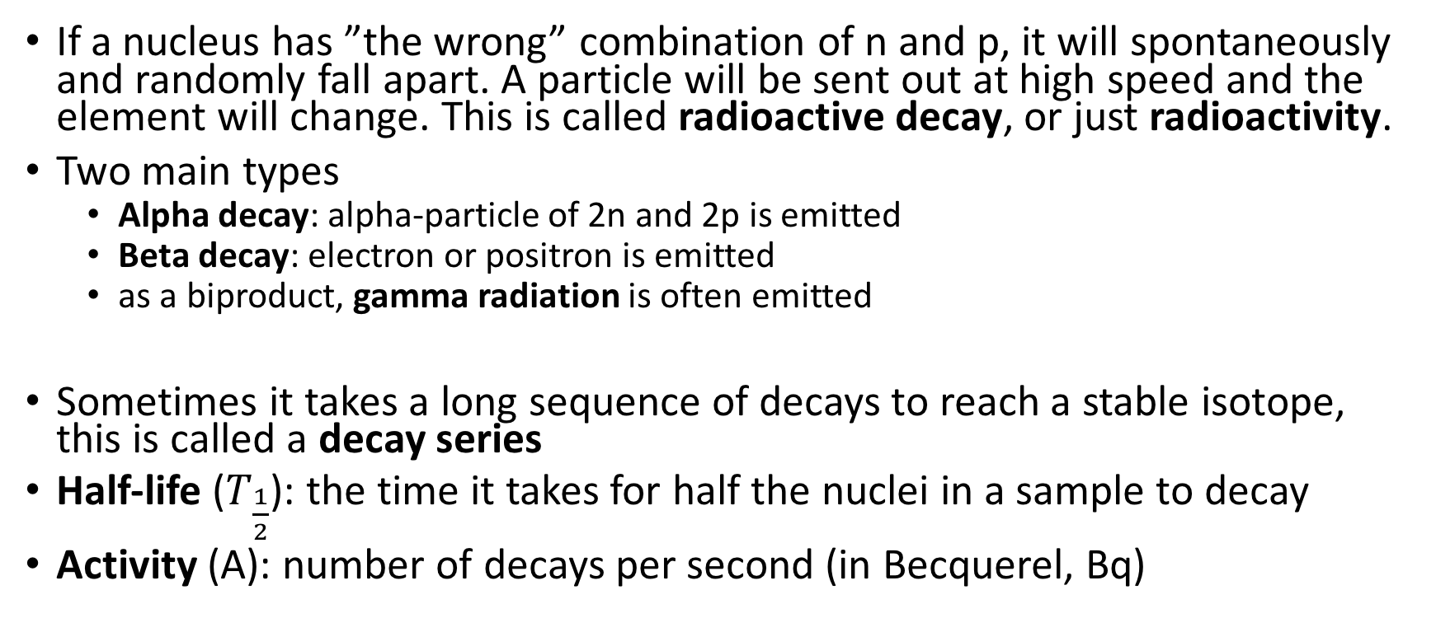
Radioactivity
If a nucleus has ”the wrong” combination of n and p, it will spontaneously and randomly fall apart. A particle will be sent out at high speed and the element will change. This is called radioactive decay, or just radioactivity.
Two main types
  Alpha decay: alpha-particle of 2n and 2p is emitted
  Beta decay: electron or positron is emitted
  as a biproduct, gamma radiation is often emitted
Sometimes it takes a long sequence of decays to reach a stable isotope, this is called a decay series
Half-life ($T_{\frac{1}{2}}$): the time it takes for half the nuclei in a sample to decay
Activity (A): number of decays per second (in Becquerel, Bq)

Slide 17
Ionizing radiation: strong enough the break chemical bonds (e.g. in the DNA molecule)
  High-energy EM radiation: gamma, X, UV
  Beta radiation
  Alpha radiation
Radiation protection
Radiation | Stopped by
Alpha | 10 cm air or layer of dead skin cells
Beta | 1 mm metal
Gamma | 10 cm lead
X-rays | 1 cm lead
UV | UVA: sunscreen, UVB: clothes, UVC: ozone layer

Slide 18
Radiation sources
  Radon gas (~50%)
  Medical treatments (~20%)
  Ground, buildings (~10%)
  Food (~10%)
  Cosmic rays (~10%) (Much more for frequent fliers!)
  Nuclear accidents, nuclear weapon testing (>1%)

