Slide 1
Rounding:
  Never round before you get your final answer!
  Always round your final answer!
  Round according to weakest link of input
    Mult/div: number of significant figures
    (Add/sub: least number of decimal places)

Slide 2
1.2 Uncertainties and errors
Systematic errors
  Due to some miscalibration of the instrument OR consistent misuse by operator
  Check with other instruments and other operators!
Random errors
  Real measurements always fluctuate around the ”actual” value
  Random errors can be reduced by repeated measurements
  Reading errors are a special case, usually taken as half the minimum reading of the instrument

Slide 3
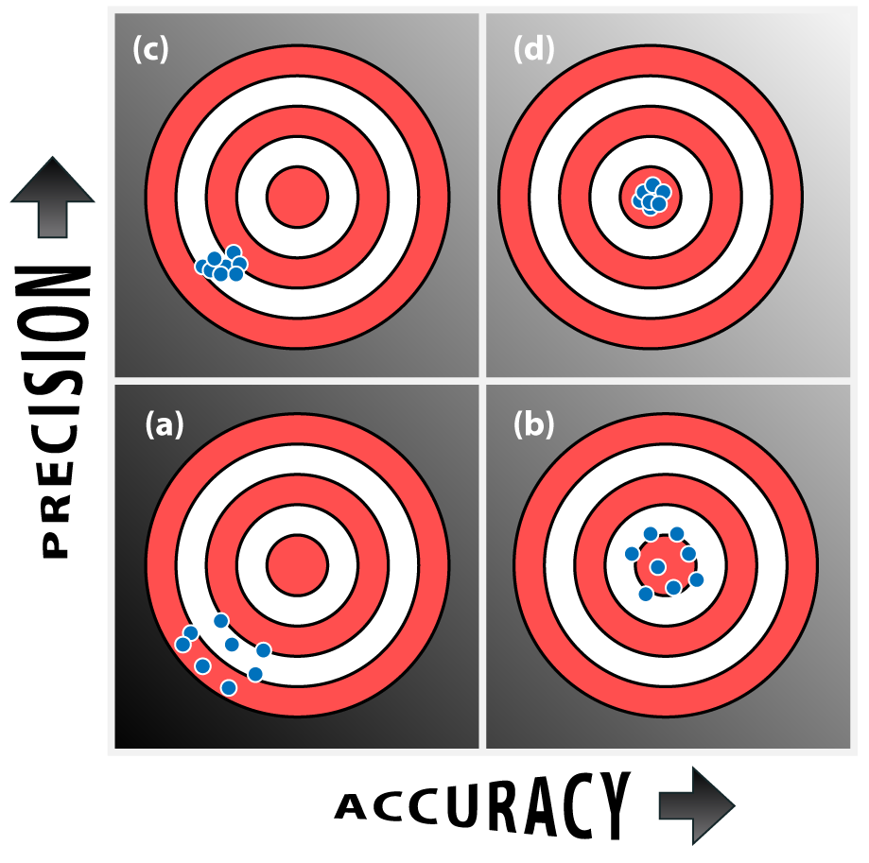
Measurements are accurate if the systematic error is small
Measurents are precise if the random error is small
Usually we want accurate and precise measurements!

Slide 4
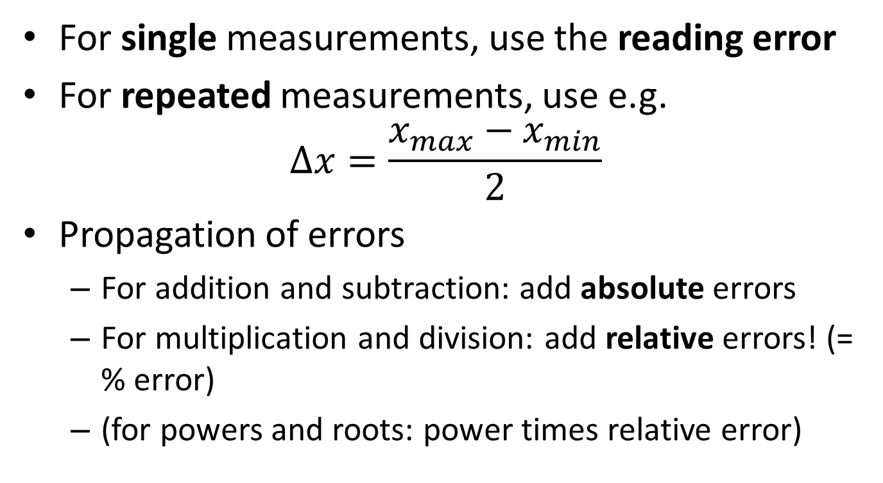
For single measurements, use the reading error
For repeated measurements, use e.g.
$∆x=\frac{x_{max}−x_{min}}{2}$
Propagation of errors
  For addition and subtraction: add absolute errors
  For multiplication and division: add relative errors! (= % error)
  (for powers and roots: power times relative error)

Slide 5
1. What is the thickness of your book? Give the answer with absolute and relative errors.

Slide 6
2. Calculate the thickness (with absolute and relative error) of two books?

Slide 7
3. What is the volume (with absolute and relative error) of your textbook?

Slide 8
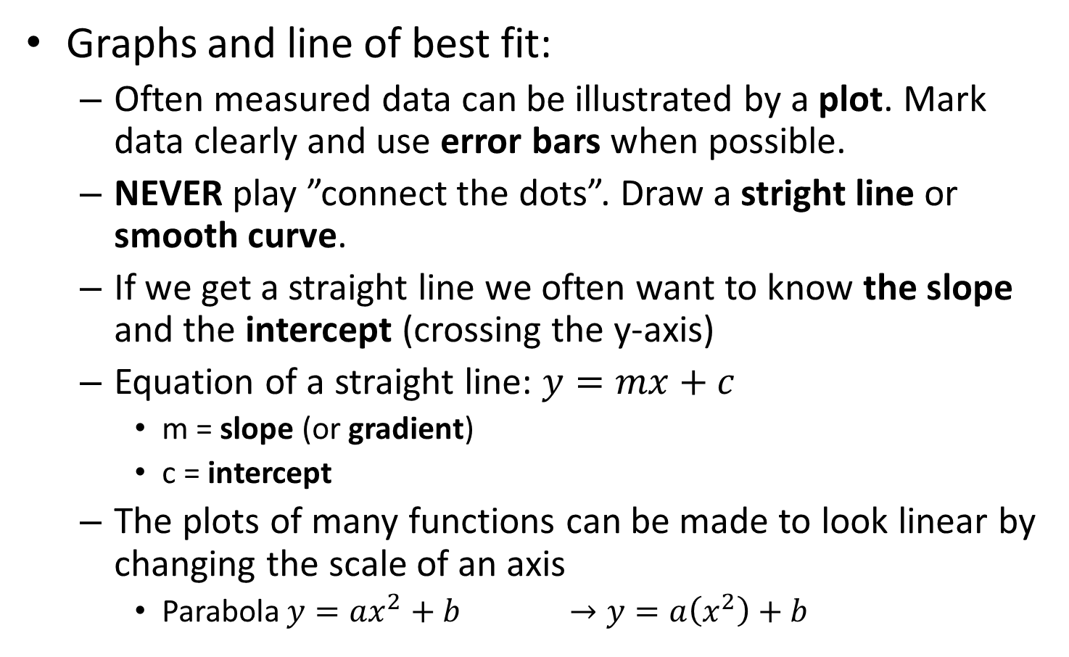
Graphs and line of best fit:
  Often measured data can be illustrated by a plot. Mark data clearly and use error bars when possible.
  NEVER play ”connect the dots”. Draw a stright line or smooth curve.
  If we get a straight line we often want to know the slope and the intercept (crossing the y-axis)
  Equation of a straight line: $y=mx+c$
    m = slope (or gradient)
    c = intercept
  The plots of many functions can be made to look linear by changing the scale of an axis
    Parabola $y=ax^{2}+b$ $→y=a\left(x^{2}\right)+b$

