Slide 1
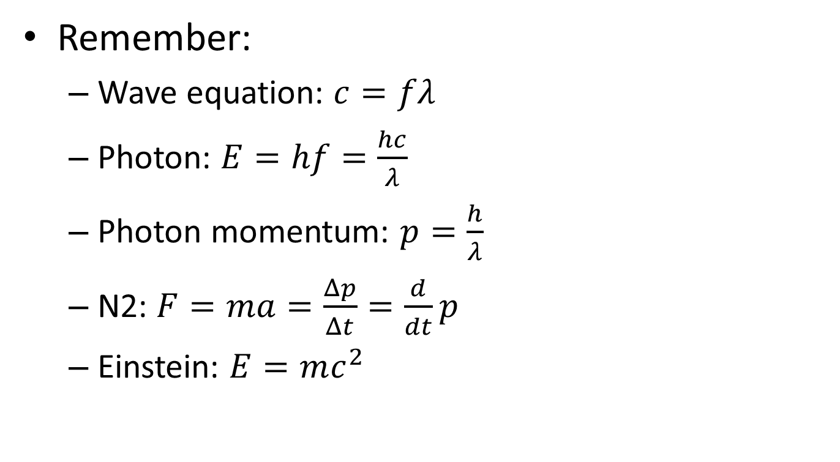
12.1 Interaction of matter with radiation
Remember:
  Wave equation: $c=fλ$
  Photon: $E=hf=\frac{hc}{λ}$
  Photon momentum: $p=\frac{h}{λ}$
  N2: $F=ma=\frac{Δp}{Δt}=\frac{d}{dt}p$
  Einstein: $E=mc^{2}$

Slide 2
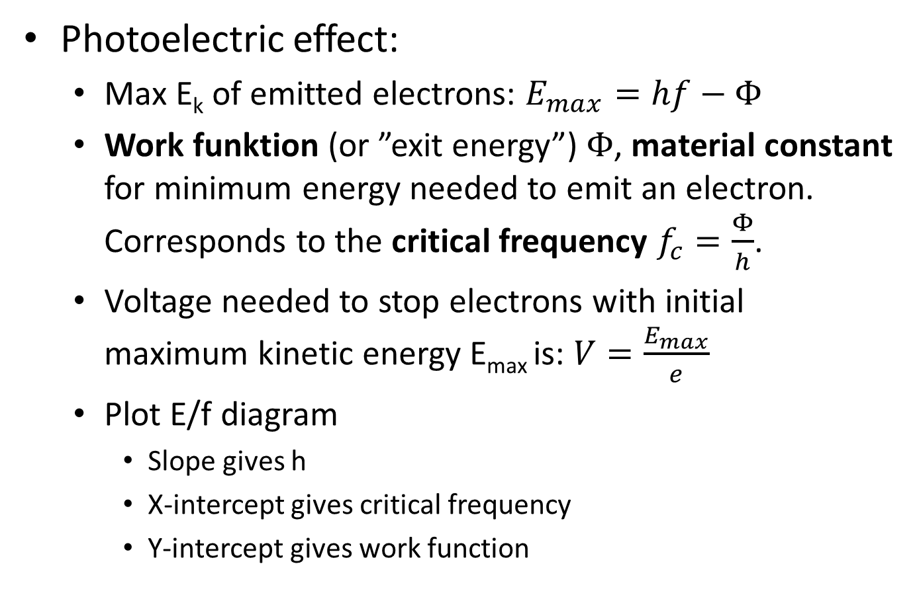
Photoelectric effect:
  Max E_{k} of emitted electrons: $E_{max}=hf−Φ$
  Work funktion (or ”exit energy”) $Φ$, material constant for minimum energy needed to emit an electron. Corresponds to the critical frequency $f_{c}=\frac{Φ}{h}$.
  Voltage needed to stop electrons with initial maximum kinetic energy E_{max} is: $V=\frac{E_{max}}{e}$
  Plot E/f diagram
    Slope gives h
    X-intercept gives critical frequency
    Y-intercept gives work function

Slide 3
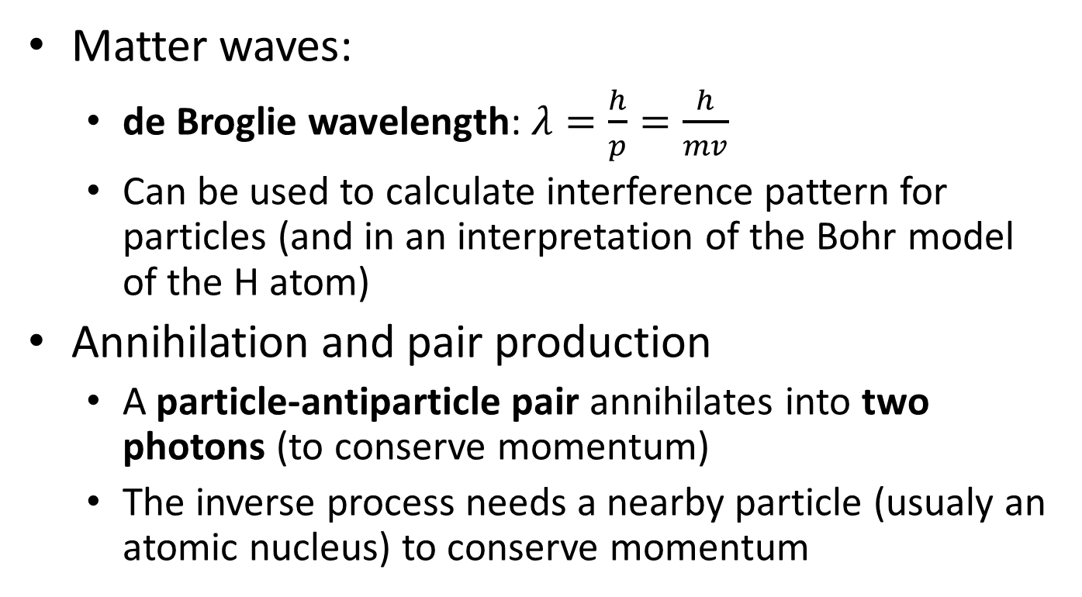
Matter waves:
  de Broglie wavelength: $λ=\frac{h}{p}=\frac{h}{mv}$
  Can be used to calculate interference pattern for particles (and in an interpretation of the Bohr model of the H atom)
Annihilation and pair production
  A particle-antiparticle pair annihilates into two photons (to conserve momentum)
  The inverse process needs a nearby particle (usualy an atomic nucleus) to conserve momentum

Slide 4
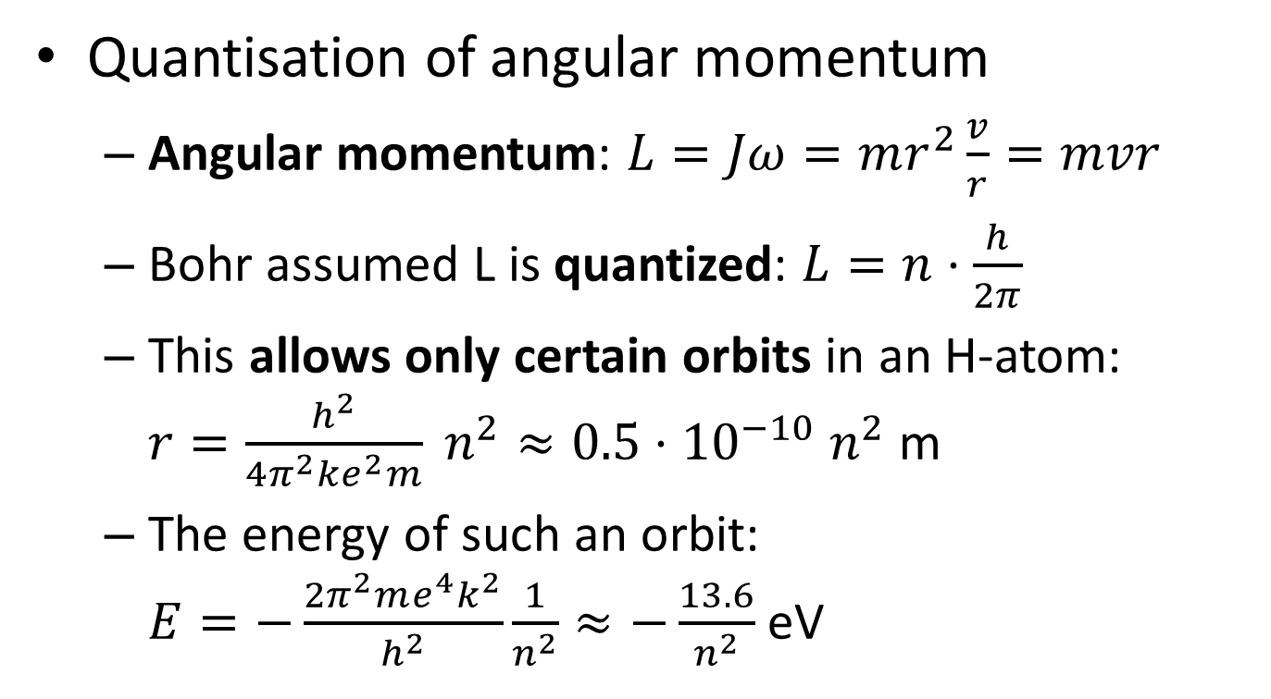
Quantisation of angular momentum
  Angular momentum: $L=Jω=mr^{2}\frac{v}{r}=mvr$
  Bohr assumed L is quantized: $L=n⋅\frac{h}{2π}$
  This allows only certain orbits in an H-atom: $r=\frac{h^{2}}{4π^{2}ke^{2}m} n^{2}≈0.5⋅{10}^{−10} n^{2}$ m
  The energy of such an orbit:
  $E=−\frac{2π^{2}me^{4}k^{2}}{h^{2}}\frac{1}{n^{2}}≈−\frac{13.6}{n^{2}}$ eV

Slide 5



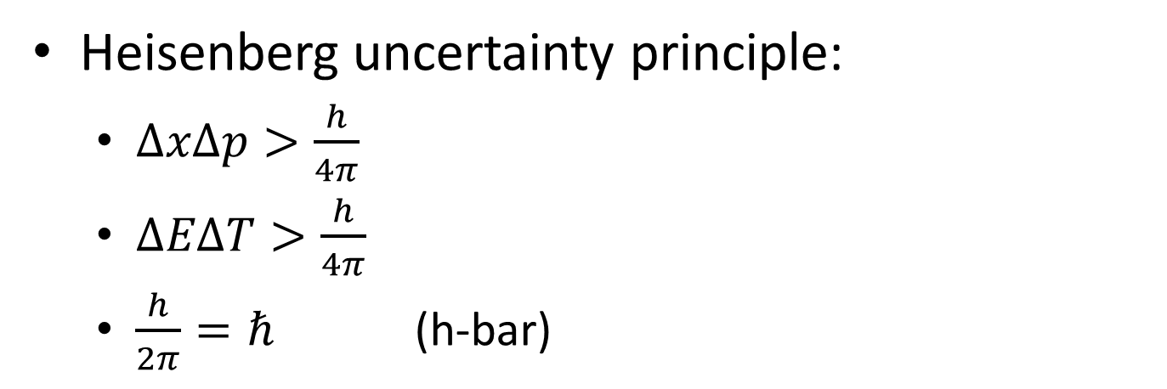
Scrödinger wave function: $\hat{H}ψ=Eψ$
Heisenberg uncertainty principle:
  $ΔxΔp>\frac{h}{4π}$
  $ΔEΔT>\frac{h}{4π}$
  $\frac{h}{2π}=ℏ$ (h-bar)

