Slide 1
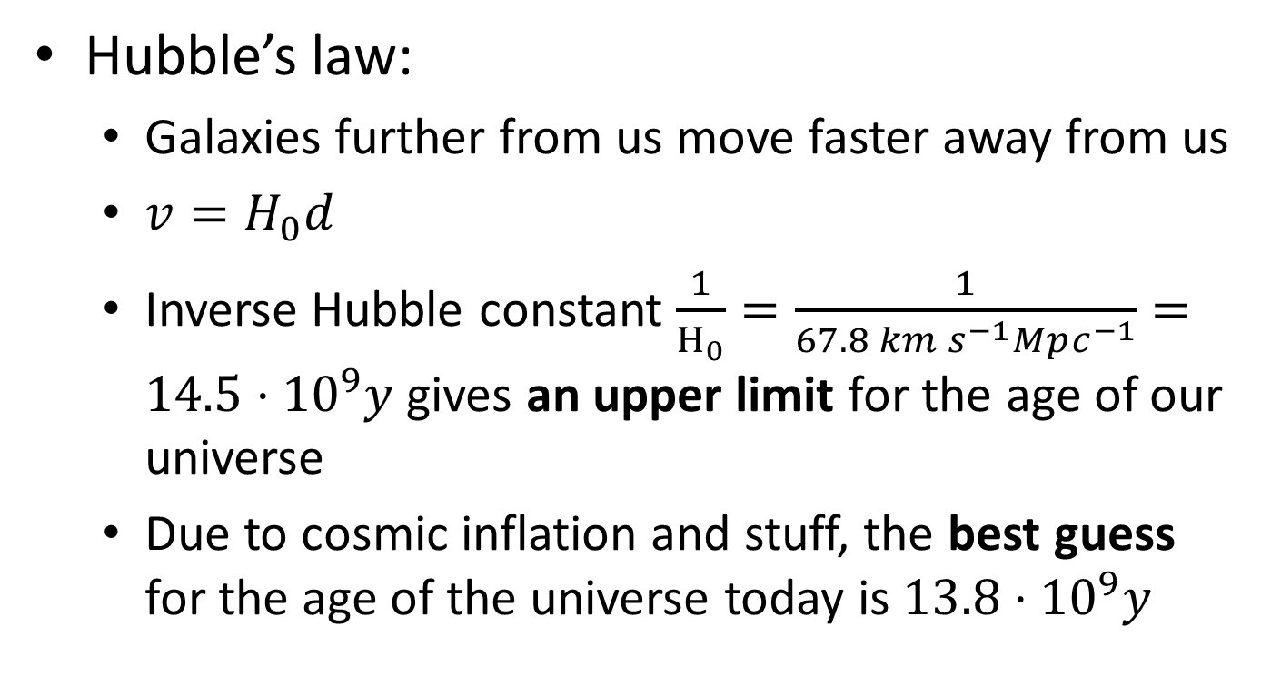
D3 Cosmology
Hubble’s law:
  Galaxies further from us move faster away from us
  $v=H_{0}d$
  Inverse Hubble constant $\frac{1}{H_{0}}=\frac{1}{67.8 km s^{−1}Mpc^{−1}}=14.5⋅{10}^{9}y$ gives an upper limit for the age of our universe
  Due to cosmic inflation and stuff, the best guess for the age of the universe today is $13.8⋅{10}^{9}y$

Slide 2
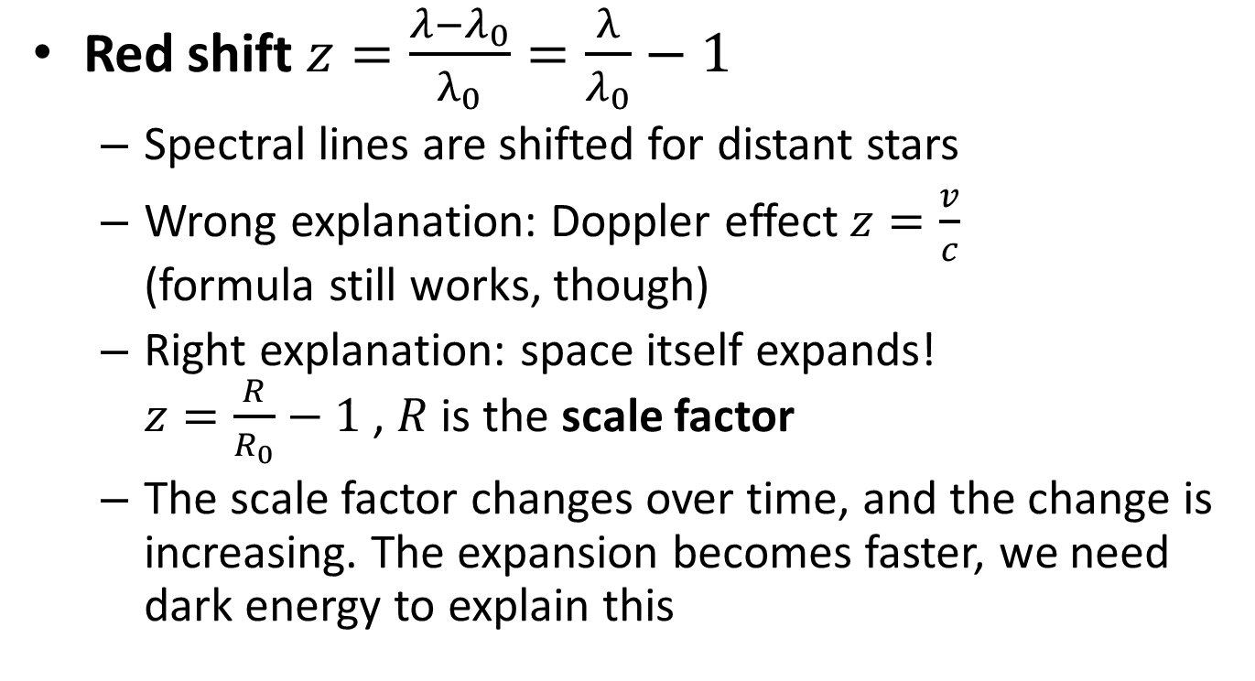
Red shift $z=\frac{λ−λ_{0}}{λ_{0}}=\frac{λ}{λ_{0}}−1$
  Spectral lines are shifted for distant stars
  Wrong explanation: Doppler effect $z=\frac{v}{c}$
  (formula still works, though)
  Right explanation: space itself expands!
  $z=\frac{R}{R_{0}}−1$ , $R$ is the scale factor
  The scale factor changes over time, and the change is increasing. The expansion becomes faster, we need dark energy to explain this

Slide 3
Cosmic microwave background (CMB)
  Big Bang created space, time and energy
  When atoms formed, light could escape
  Space has since stretched so the waves are now 1.07 mm (corresponding to 2.7 K)
  This CMB is the same in all directions of space
  Tiny fluctuations give a hint how stars and galaxies could form

