Slide 1
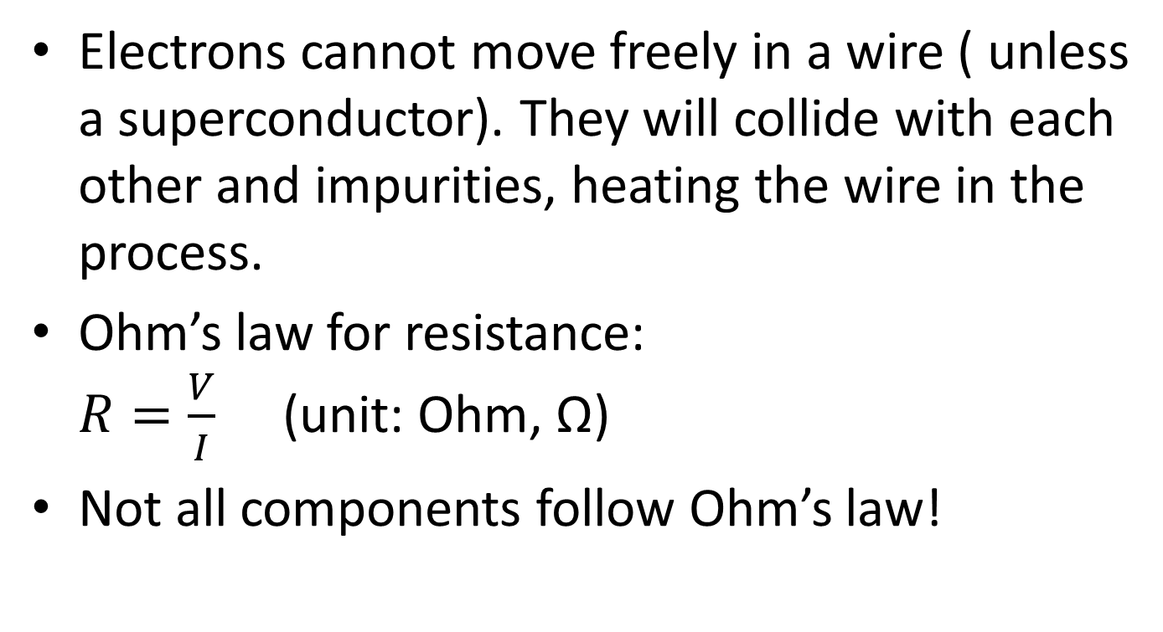
5.2 Circuits
Electrons cannot move freely in a wire ( unless a superconductor). They will collide with each other and impurities, heating the wire in the process.
Ohm’s law for resistance:
$R=\frac{V}{I}$ (unit: Ohm, Ω)
Not all components follow Ohm’s law!

Slide 2
Lab1. Connect a light bulb to a battery. Measure the resistance while the light is on. Make a circuit diagram!
Note! Voltmeter ALWAYS parallel to the measured component, Ammeter ALWAYS in series with the measured component!

Slide 3
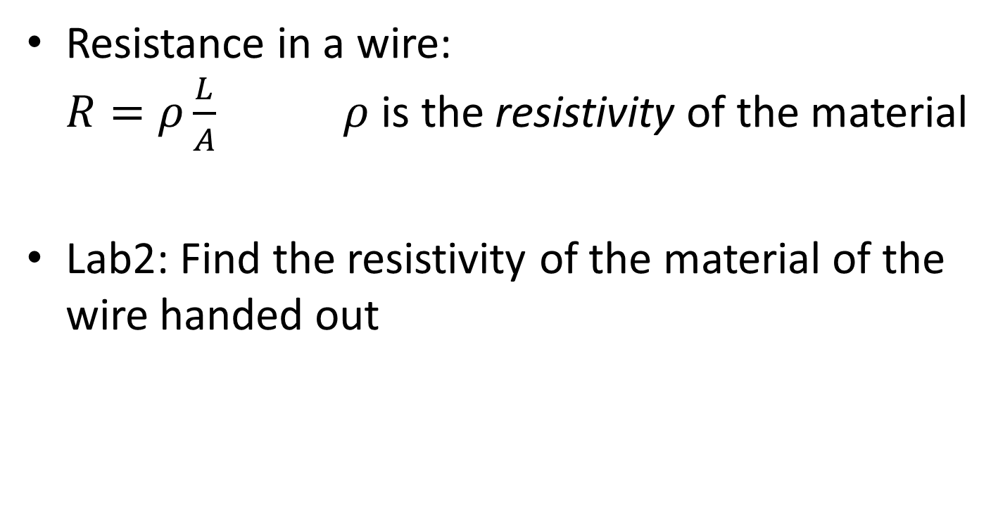
Resistance in a wire:
$R=ρ\frac{L}{A}$ $ρ$ is the resistivity of the material
Lab2: Find the resistivity of the material of the wire handed out

Slide 4
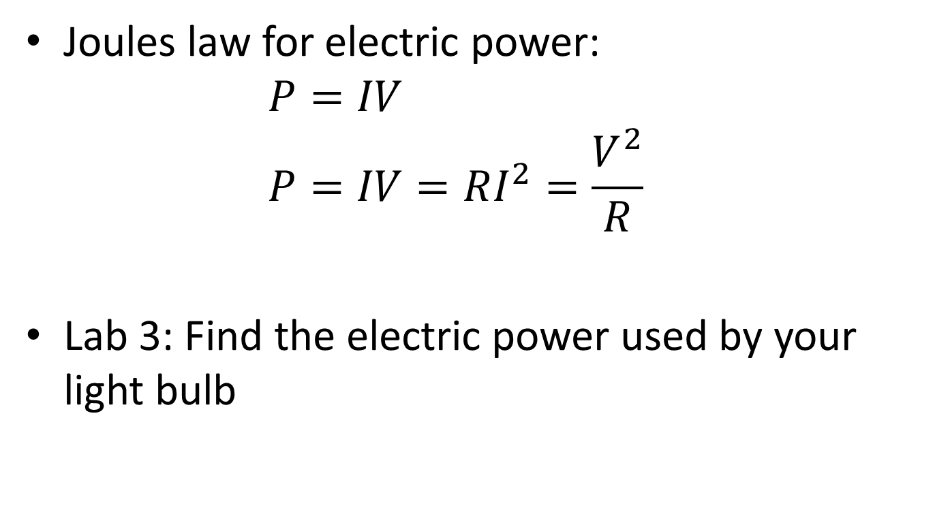
Joules law for electric power:
$P=IV$
$P=IV=RI^{2}=\frac{V^{2}}{R}$
Lab 3: Find the electric power used by your light bulb

Slide 5
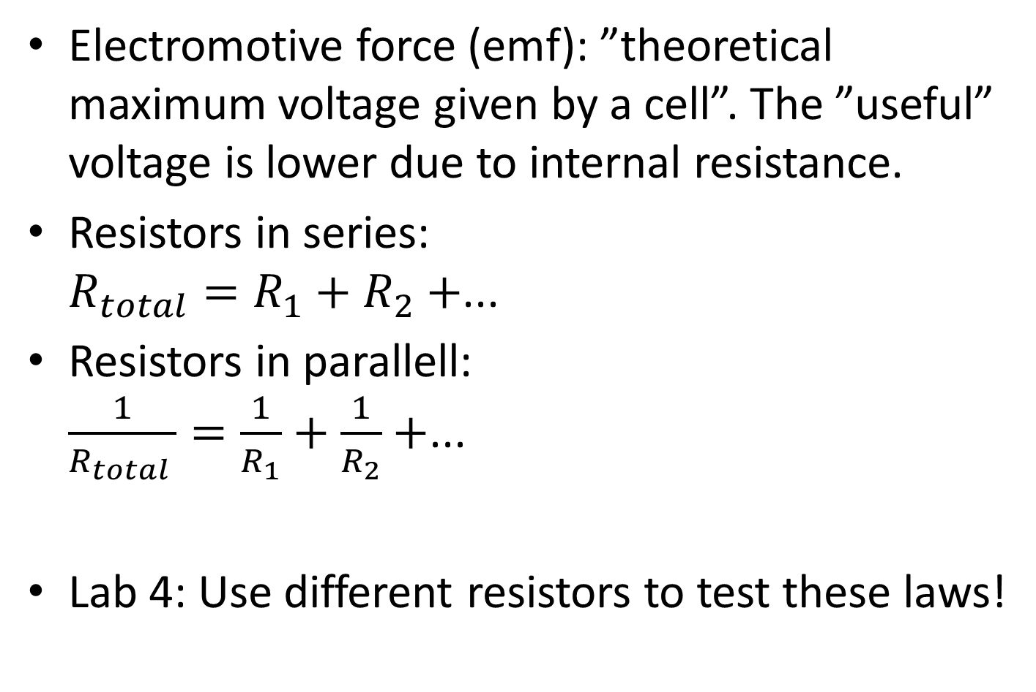
Electromotive force (emf): ”theoretical maximum voltage given by a cell”. The ”useful” voltage is lower due to internal resistance.
Resistors in series:
$R_{total}=R_{1}+R_{2}+$...
Resistors in parallell:
$\frac{1}{R_{total }}=\frac{1}{R_{1}}+\frac{1}{R_{2}}+$...
Lab 4: Use different resistors to test these laws!

Slide 6
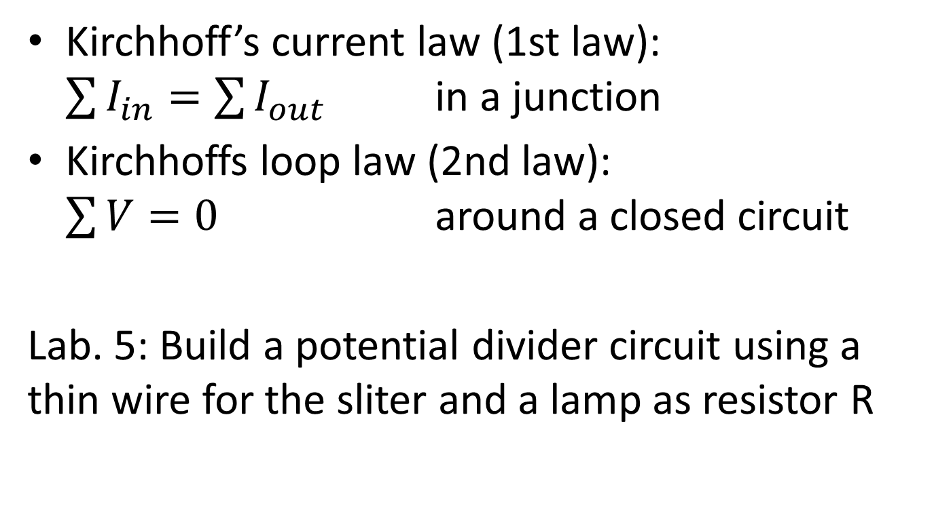
Kirchhoff’s current law (1st law):
$\sum{I_{in}=\sum{I_{out}}}$ in a junction
Kirchhoffs loop law (2nd law):
$\sum{V=0}$ around a closed circuit
Lab. 5: Build a potential divider circuit using a thin wire for the sliter and a lamp as resistor R

