Slide 1
5.1 Electric fields
 | Electricity | Gravitation

Slide 2
5.1 Electric fields
 | Electricity | Gravitation
Property of matter | Charge (Q) in Coulomb (C) | Mass (m) in kilogram (kg)

Slide 3
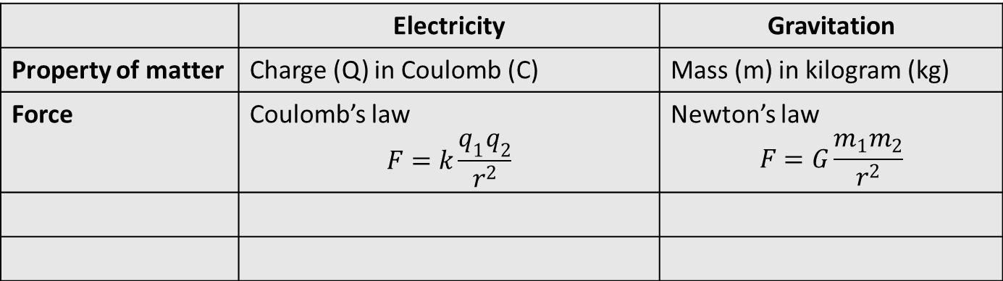
5.1 Electric fields
 | Electricity | Gravitation
Property of matter | Charge (Q) in Coulomb (C) | Mass (m) in kilogram (kg)
Force | Coulomb’s law $$F=k\frac{q_{1}q_{2}}{r^{2}}$$ | Newton’s law $$F=G\frac{m_{1}m_{2}}{r^{2}}$$

Slide 4
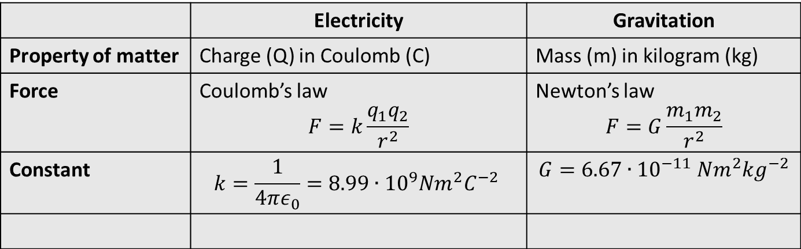
5.1 Electric fields
 | Electricity | Gravitation
Property of matter | Charge (Q) in Coulomb (C) | Mass (m) in kilogram (kg)
Force | Coulomb’s law $$F=k\frac{q_{1}q_{2}}{r^{2}}$$ | Newton’s law $$F=G\frac{m_{1}m_{2}}{r^{2}}$$
Constant | $$k=\frac{1}{4πε_{0}}=8.99∙{10}^{9}Nm^{2}C^{−2}$$ | $$G=6.67∙{10}^{−11} Nm^{2}kg^{−2}$$

Slide 5
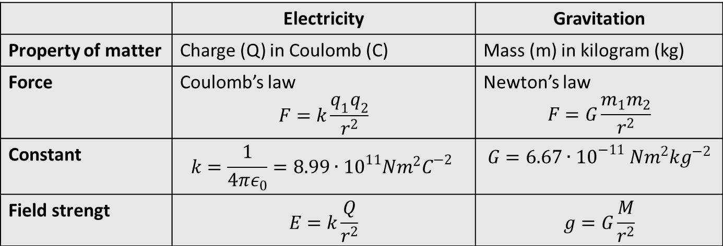
5.1 Electric fields
 | Electricity | Gravitation
Property of matter | Charge (Q) in Coulomb (C) | Mass (m) in kilogram (kg)
Force | Coulomb’s law $$F=k\frac{q_{1}q_{2}}{r^{2}}$$ | Newton’s law $$F=G\frac{m_{1}m_{2}}{r^{2}}$$
Constant | $$k=\frac{1}{4πε_{0}}=8.99∙{10}^{11}Nm^{2}C^{−2}$$ | $$G=6.67∙{10}^{−11} Nm^{2}kg^{−2}$$
Field strengt | $$E=k\frac{Q}{r^{2}}$$ | $$g=G\frac{M}{r^{2}}$$

Slide 6
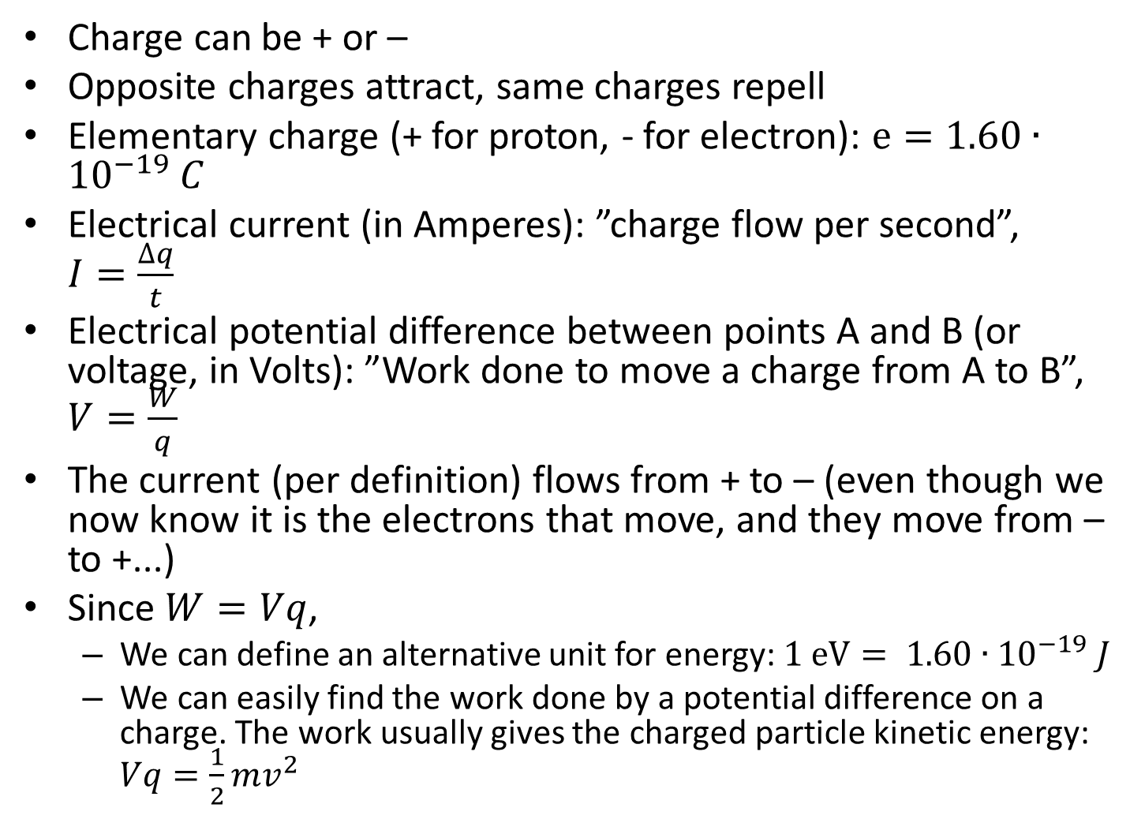
Charge can be + or –
Opposite charges attract, same charges repell
Elementary charge (+ for proton, - for electron): $e=1.60∙{10}^{−19} C$
Electrical current (in Amperes): ”charge flow per second”, $I=\frac{∆q}{t}$
Electrical potential difference between points A and B (or voltage, in Volts): ”Work done to move a charge from A to B”, $V=\frac{W}{q}$
The current (per definition) flows from + to – (even though we now know it is the electrons that move, and they move from – to +...)
Since $W=Vq$,
  We can define an alternative unit for energy: $1 eV= 1.60∙{10}^{−19} J$
  We can easily find the work done by a potential difference on a charge. The work usually gives the charged particle kinetic energy: $Vq=\frac{1}{2}mv^{2}$

