Slide 1
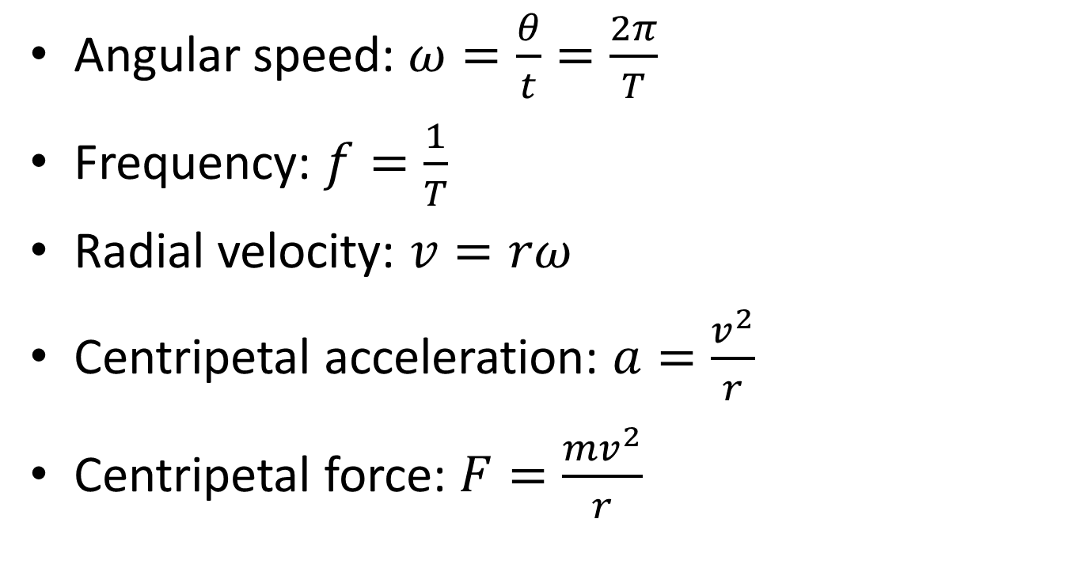
6.1 Circular motion
Angular speed: $ω=\frac{θ}{t}=\frac{2π}{T}$
Frequency: $f=\frac{1}{T}$
Radial velocity: $v=rω$
Centripetal acceleration: $a=\frac{v^{2}}{r}$
Centripetal force: $F=\frac{mv^{2}}{r}$

