Slide 1
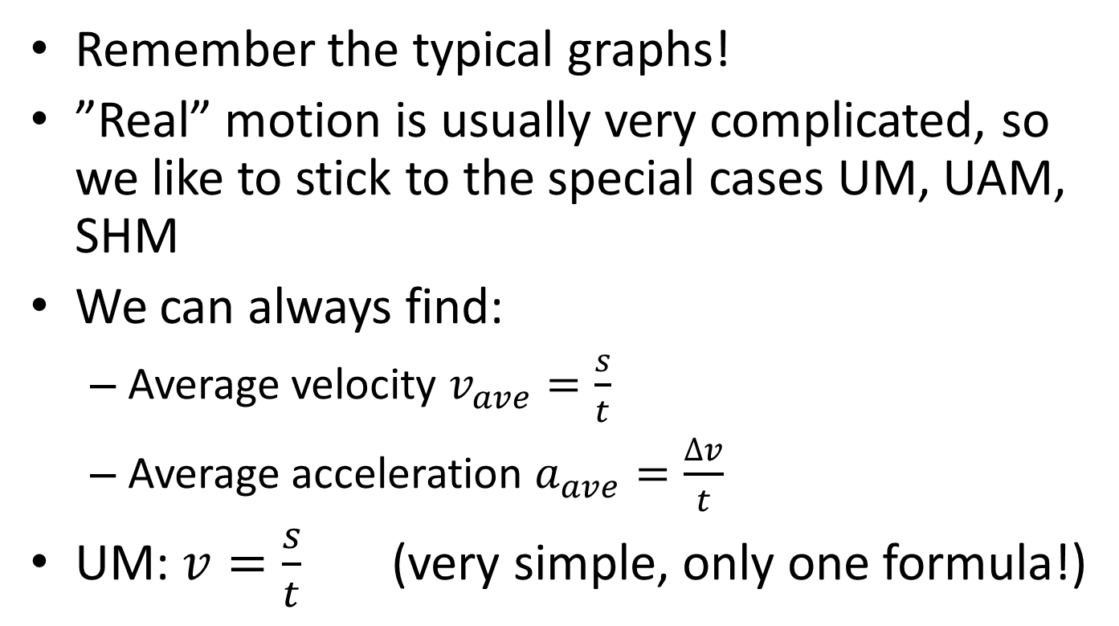
2.1 Motion
Remember the typical graphs!
”Real” motion is usually very complicated, so we like to stick to the special cases UM, UAM, SHM
We can always find:
  Average velocity $v_{ave}=\frac{s}{t}$
  Average acceleration $a_{ave}=\frac{∆v}{t}$
UM: $v=\frac{s}{t}$ (very simple, only one formula!)

Slide 2
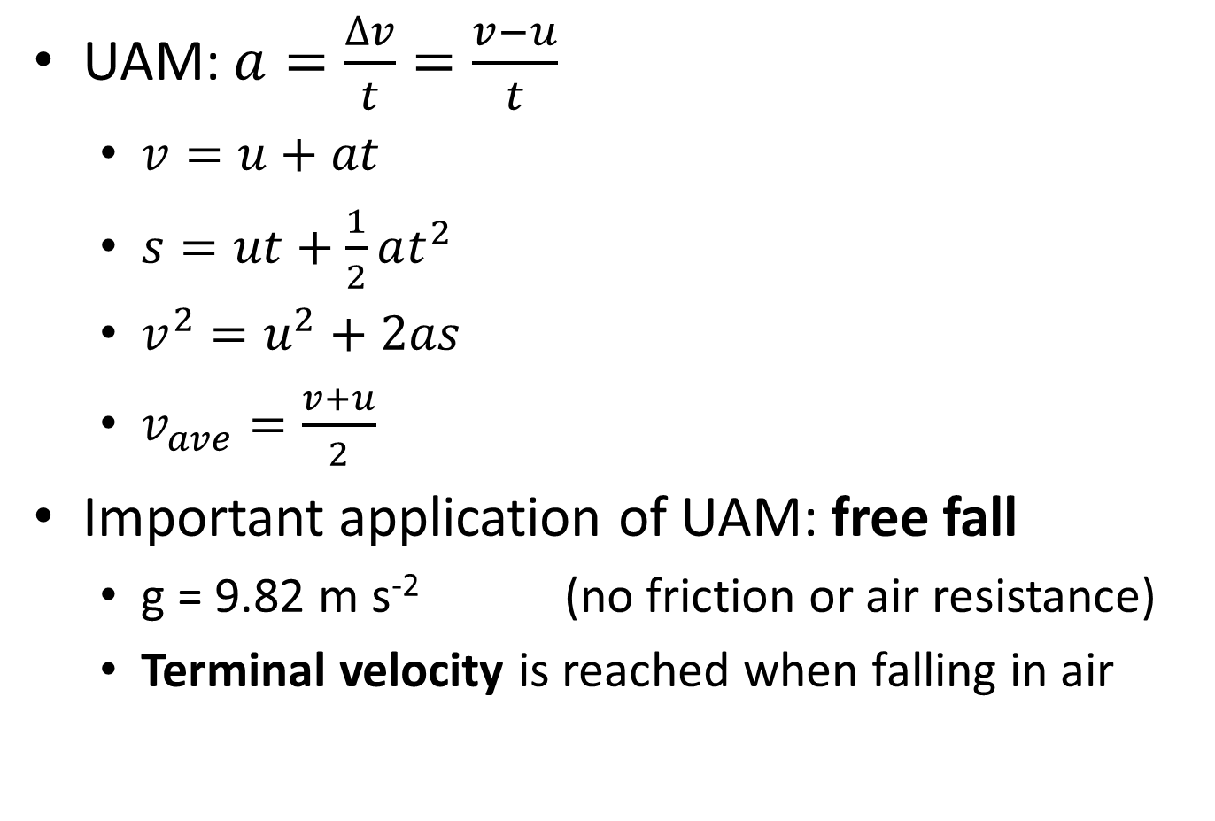
UAM: $a=\frac{∆v}{t}=\frac{v−u}{t}$
  $v=u+at$
  $s=ut+\frac{1}{2}at^{2}$
  $v^{2}=u^{2}+2as$
  $v_{ave}=\frac{v+u}{2}$
Important application of UAM: free fall
  g = 9.82 m s⁻² (no friction or air resistance)
  Terminal velocity is reached when falling in air

Slide 3
For all types of motion we can analyze the graphs:
Graph type | Slope | Area
s-t | Velocity
v-t | Acceleration | Change in position
a-t |  | Change in velocity

Slide 4
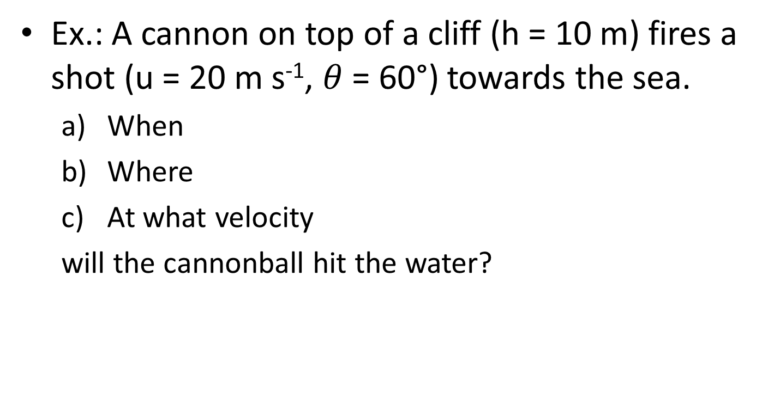
Ex.: A cannon on top of a cliff (h = 10 m) fires a shot (u = 20 m s⁻¹, $θ$ = 60°) towards the sea.
  When
  Where
  At what velocity
  will the cannonball hit the water?

Slide 5
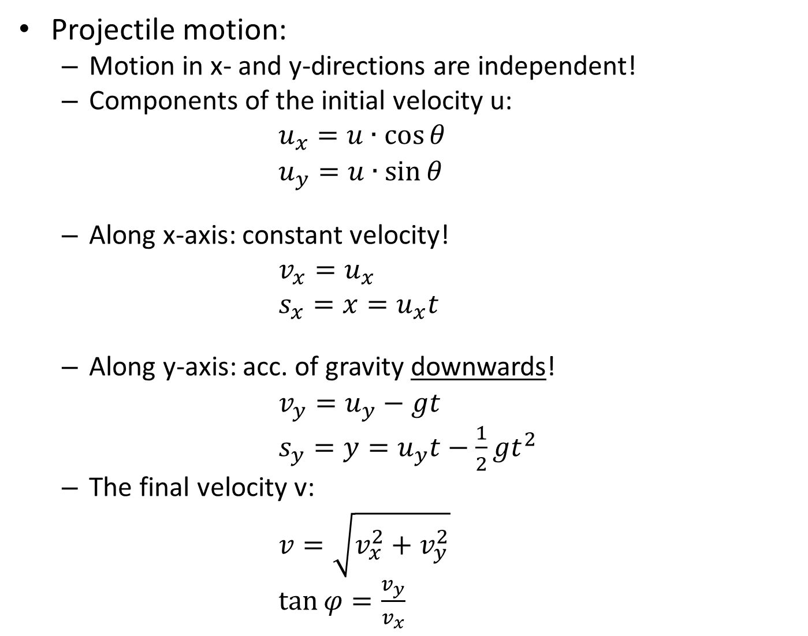
Projectile motion:
  Motion in x- and y-directions are independent!
  Components of the initial velocity u:
  $u_{x}=u∙\cos{θ}$
  $u_{y}=u∙\sin{θ}$
  Along x-axis: constant velocity!
  $v_{x}=u_{x}$
  $s_{x}=x=u_{x}t$
  Along y-axis: acc. of gravity downwards!
  $v_{y}=u_{y}−gt$
  $s_{y}=y=u_{y}t−\frac{1}{2}gt^{2}$
  The final velocity v:
  $v=\sqrt{v_{x}^{2}+v_{y}^{2}}$
  $\tan{φ=\frac{v_{y}}{v_{x}}}$

