Slide 1
9.3 Interference
(Double slit and multiple slits)
For a double slit with very very very small openings:

Slide 2
Screen
Double slit
d
Same path lenght
gives constructive interference
which gives a bright spot in the middle

Slide 3
Screen
Double slit
One half wavelength gives destructive interference = dark spot
d

Slide 4
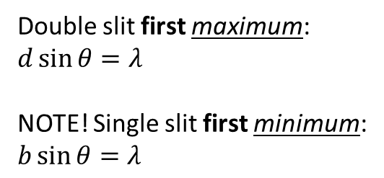
Screen
Double slit
One full wavelength gives constructive interference = bright spot
d
θ
θ
Double slit first maximum:
$d\sin{θ=λ}$
NOTE! Single slit first minimum:
$b\sin{θ=λ}$

Slide 5
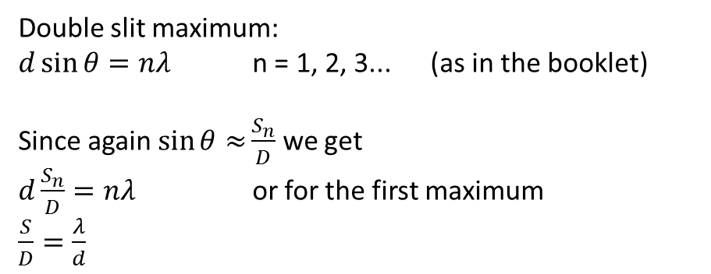
Screen
Double slit
Two full wavelengths give constructive interference = bright spot
S_{n}
d
D
Double slit maximum:
$d\sin{θ=nλ}$ n = 1, 2, 3... (as in the booklet)
Since again $\sin{θ≈}\frac{S_{n}}{D}$ we get
$d\frac{S_{n}}{D}=nλ$ or for the first maximum
$\frac{S}{D}=\frac{λ}{d}$

Slide 6
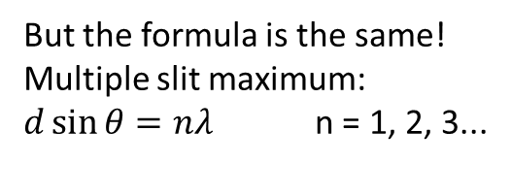
Screen
Multiple slit
The more slits you have,
the narrower and brighter the bright spots become!
d
Many slits together are called a grating.
But the formula is the same!
Multiple slit maximum:
$d\sin{θ=nλ}$ n = 1, 2, 3...

Slide 7
Screen
Double slit
If the width of the openings are not very very small, you will get a combination of single-slit and double-slit patterns!
d
b

Slide 8
Babinet's principle:
  A shape and its opposite gives the same diffraction pattern!
  Single slit and single obsticle will give the same pattern, therefor we can use the single slit formula to calculate the width of a hair!
  Continue with the questions:
  p. 364: 14, 15
  p. 374: 17, 18, 19, 22

Slide 9
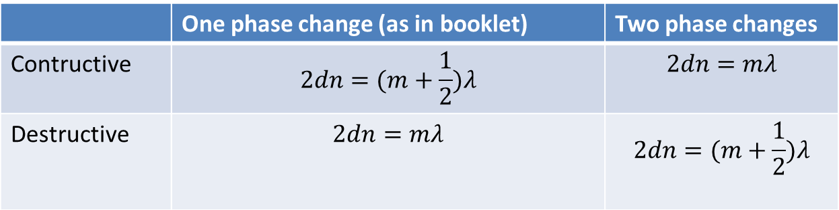
Thin film interference
  There is always both reflection and refraction when light passes from one medium to another
  Light waves change phase when reflecting off a medium of higher refractive index
  If we can make destructive interference happen less light will be reflected (used e.g. in camera lenses and solar cells)
 | One phase change (as in booklet) | Two phase changes
Contructive | $$2dn=(m+\frac{1}{2})λ$$ | $$2dn=mλ$$
Destructive | $$2dn=mλ$$ | $$2dn=(m+\frac{1}{2})λ$$

