Slide 1
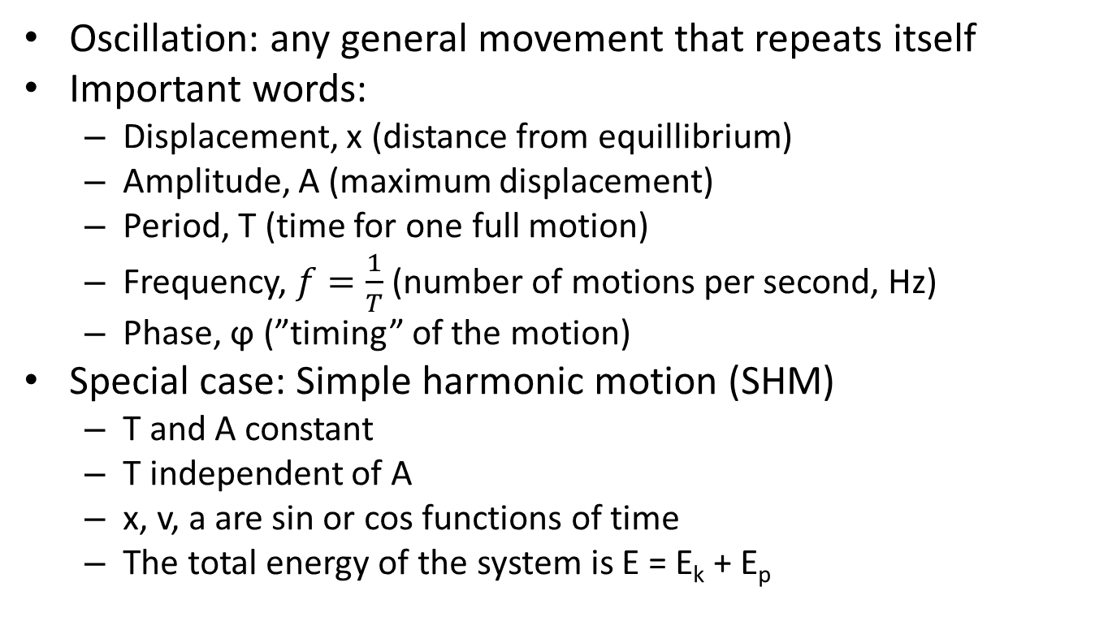
4.1 Oscillations
Oscillation: any general movement that repeats itself
Important words:
  Displacement, x (distance from equillibrium)
  Amplitude, A (maximum displacement)
  Period, T (time for one full motion)
  Frequency, $f=\frac{1}{T}$ (number of motions per second, Hz)
  Phase, ϕ (”timing” of the motion)
Special case: Simple harmonic motion (SHM)
  T and A constant
  T independent of A
  x, v, a are sin or cos functions of time
  The total energy of the system is E = E_{k} + E_{p}

